Slide 1



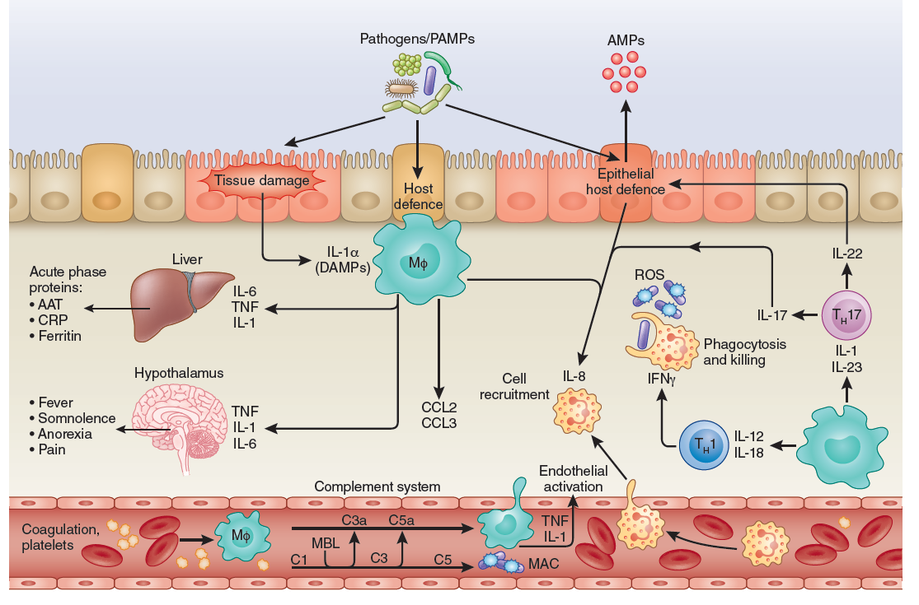
A guiding map for Inflammation
Netea et al, Nature Immunol, 2018

Slide 2
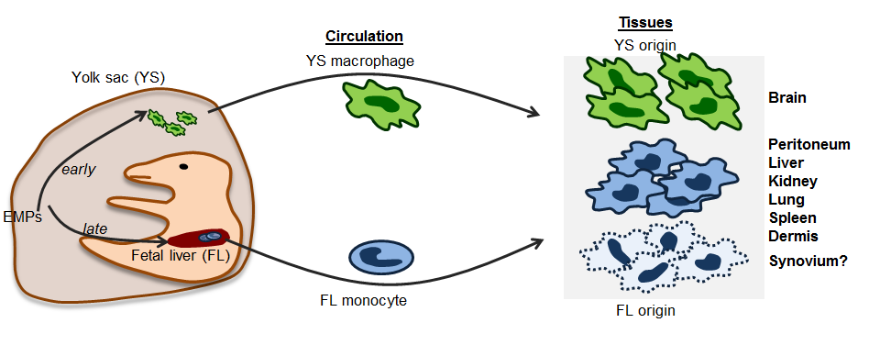
FIGURE 2: Embryonic origins of tissue resident macrophages.
The majority of tissue resident macrophages are seeded during embryonic development. YS macrophages arise first from primitive haematopoiesis and seed the embryonic tissues including the brain as early as E9.0. A wave of YS derived EMPs ( ? DEFINE EMPS) seeds the FL where definitive haematopoiesis is established on E11.0. The FL is the main site of haematopoiesis until birth. On E12.5, FL derived monocytes populate the embryo and dilute the YS derived populations However, YS macrophages remain the sole source of microglia, the brain’s resident macrophages, likely due to prior establishment of the blood brain barrier. In other tissues, resident macrophages are exclusively derived from FL monocytes. The fate mapping of tissue resident synovial macrophages has not yet been done.
(Udalova I, Mantovani A, Feldmann M, Nature Rev Rheumatol 2016)

Slide 3
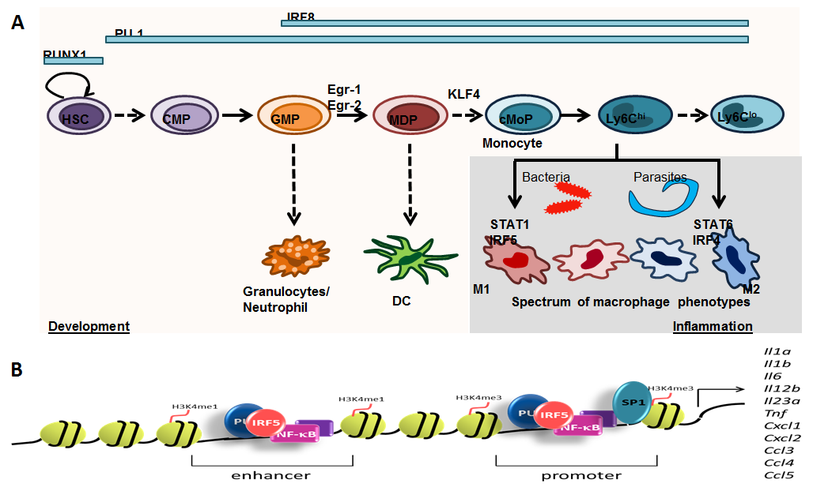
FIGURE 4: PU.1 in the transcriptional control of macrophage development and activation.
(A) RUNX1 is required during early development in HSCs followed by the onset of PU.1 expression. PU.1 is the master regulator of the myeloid lineage and crucial throughout differentiation. IRF8, Egr-1 and Egr-2 are involved in supressing granulocyte and neutrophil genes while promoting macrophage fate. KLF4 is required for monocyte/macrophage differentiation. During inflammation macrophages are shaped by the cytokine environment which depends on the nature of the infectious insult. Bacterial pathogens on the other hand cause a Th1 or Th17 type response which leads to STAT1 and IRF5 activation (classically activated M1 phenotype). Parasites lead to a Th2 driven disease activating STAT6 and IRF4 in macrophages (alternatively activated M2 phenotype). Importantly, macrophage phenotypes in vivo are manifold and thus represented as a spectrum. (B) Typical composition of PU.1 marked enhancers and promoters in classically activated M1 macrophages.
(Udalova I, Mantovani A, Feldmann M, Nature Rev Rheumatol 2016)

Slide 4

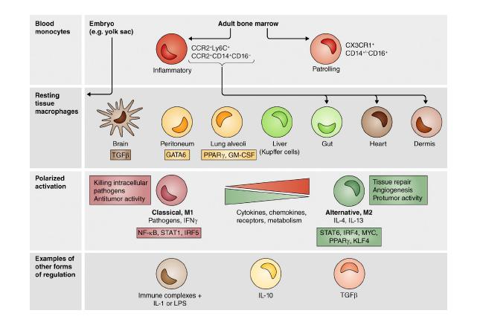
Ontogeny and regulation of cells of the monocyte-macrophage lineage
Mantovani and Allavena , J. Exp . Med 2015

Slide 5
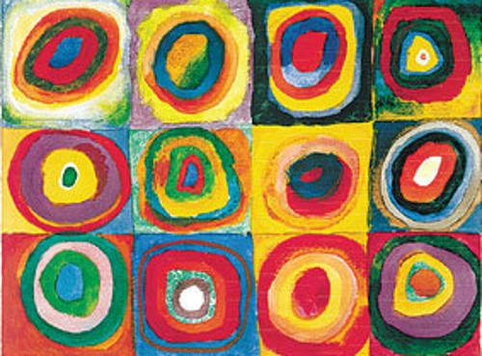

M1
M2-like
M1-like
M2
Farbstudie Quadrate, Wassily Kandinsky, 1913
«A distinct and unique transcriptional program expressed by tumor-associated macrophages (defective NF-kappaB and enhanced IRF-3/STAT1 activation)»
Biswas et al., Blood 2006
(Selected reviews: Sica and Mantovani J Clin Inv 2012; Biswas and Mantovani, Nature Immunol 2010;
Murray et al Immunity 2014; Mantovani and Allavena J Exp Med 2015; Mantovani Nature Immmunol 2016)

Slide 6
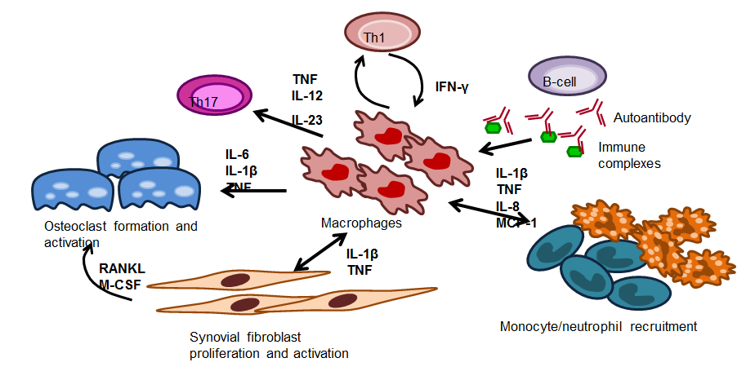
FIGURE 1: Overview of the role of macrophages in RA.
Macrophages produce cytokines which in turn promote inflammation by recruitment of additional immune cells, T-cell polarisation and fibroblast activation. Activated fibroblast secrete RANKL and M-CSF inducing osteoclast differentiation which is enhanced by macrophage derived TNF and others. Immune complexes formed by autoantibodies and antigens activate macrophages. Additionally, macrophages are influenced by cell-cell contact or cytokines produced by T-cells, fibroblasts and innate immune cells.
(Udalova I, Mantovani A, Feldmann M, Nature Rev Rheumatol 2016)

Slide 7
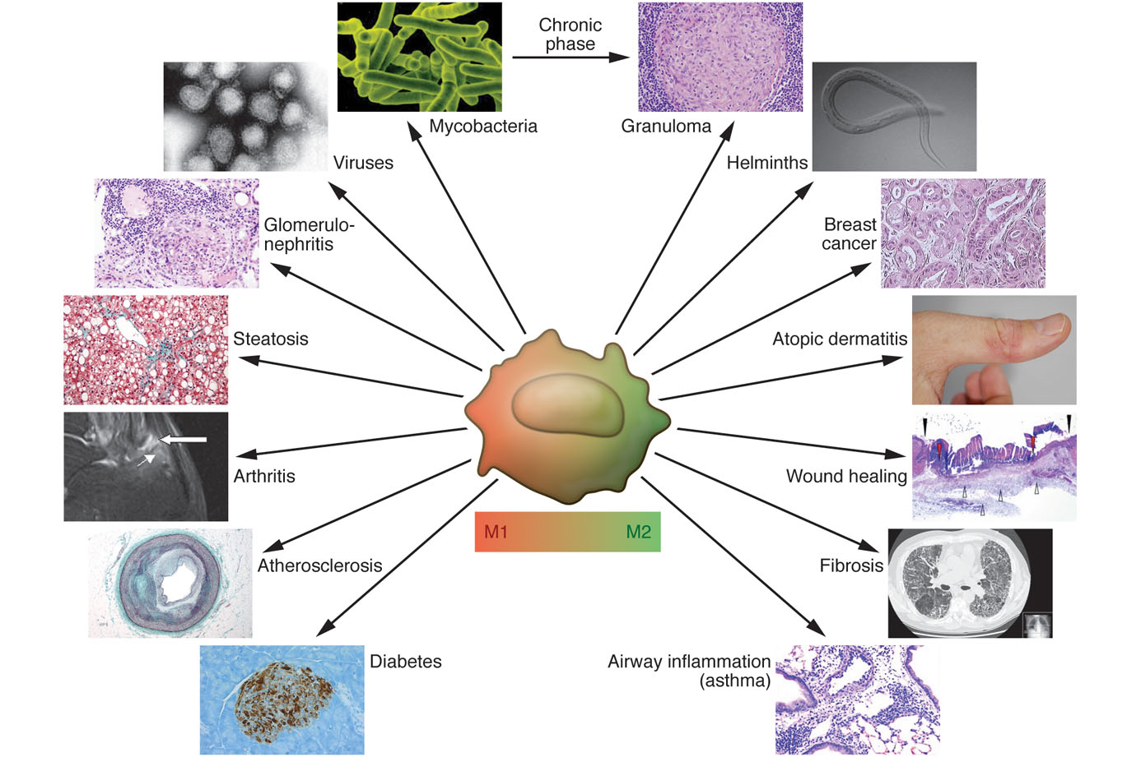
Macrophage plasticity and polarization in pathology: in vivo veritas
Sica A and Mantovani A. J. Clin. Invest. 2012

Slide 8


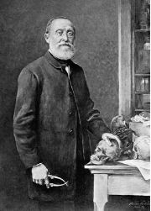
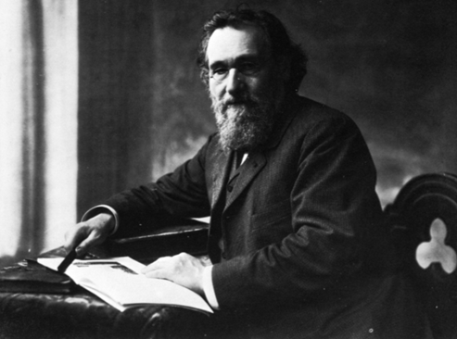
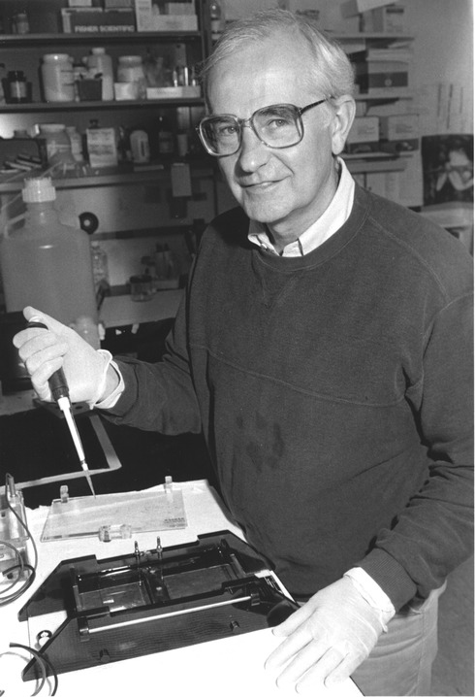
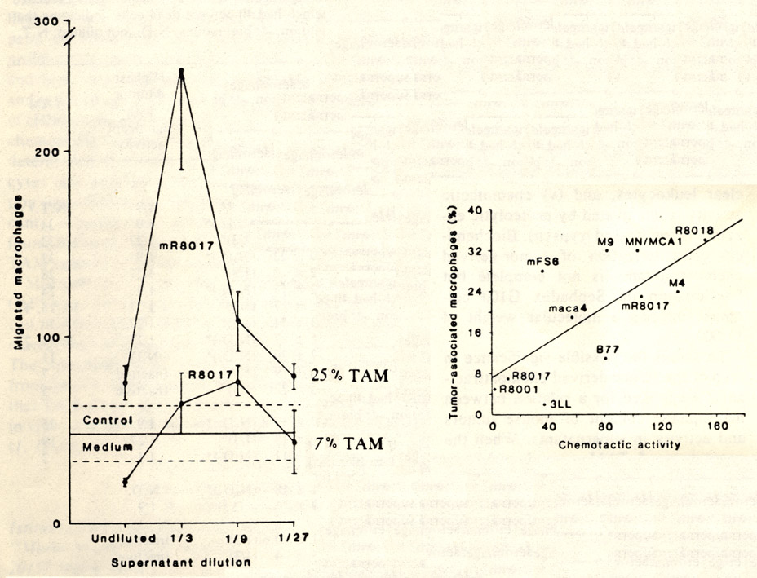
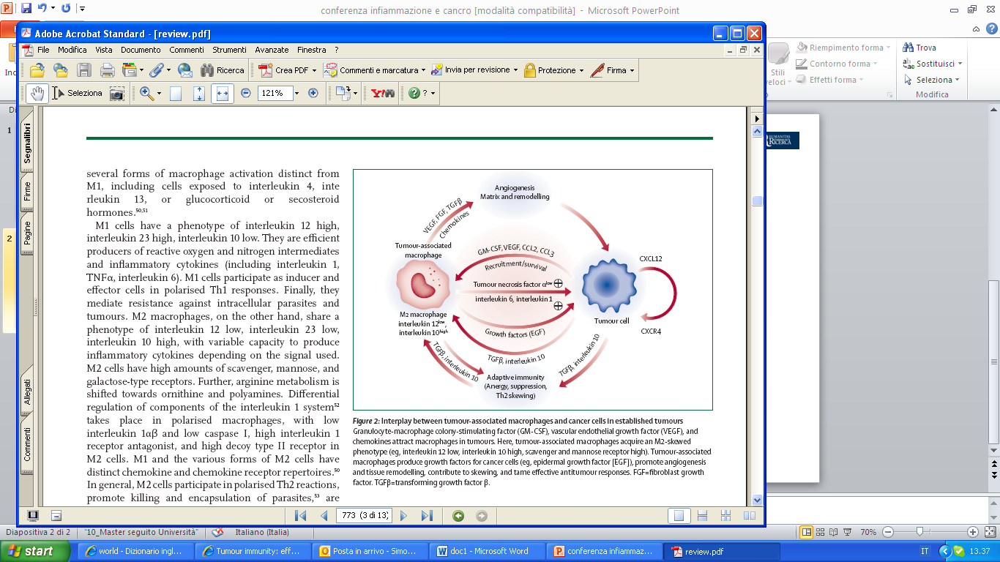
INFLAMMATION, MACROPHAGES AND CANCER
Ilya Mechnikov (1845-1916)
The Nobel Prize in Physiology and Medicine 1908
(TAM: Robert Evans, Transplantation, 1972;
Evans and Alexander, Nature, 1970)
RUDOLF LUDWIG KARL
VIRCHOW (1821-1902)
Balkwill and Mantovani, Lancet 2001
In Vitro and in vivo
(Mantovani et al. Lancet 2008; Nature 2008)
(Mantovani A. 1978)
(Bottazzi et al Science 1983)

Slide 9


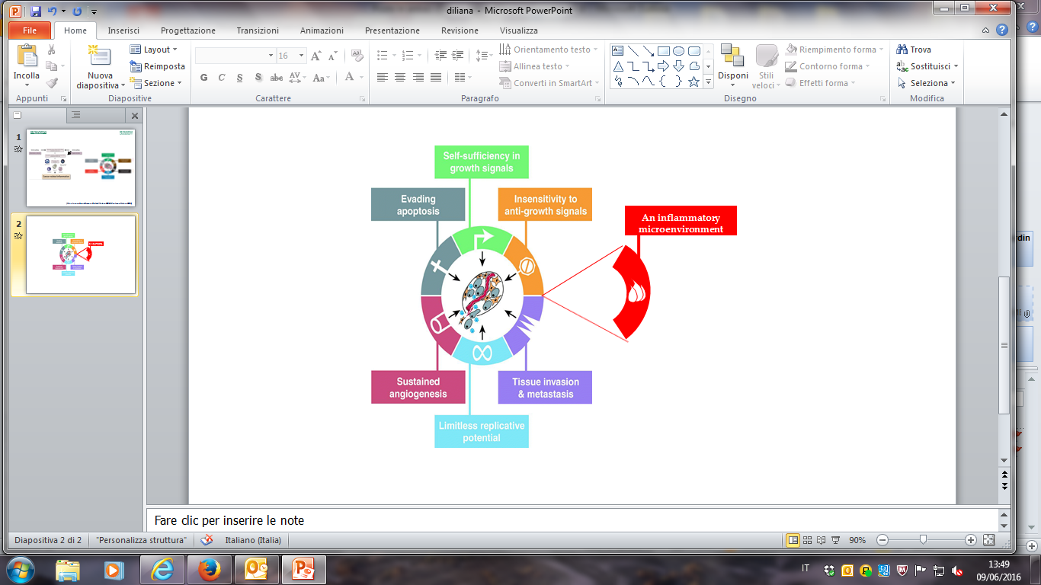
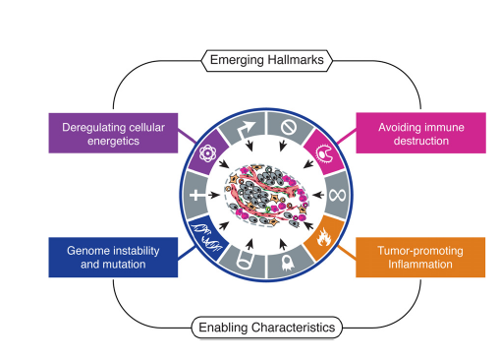
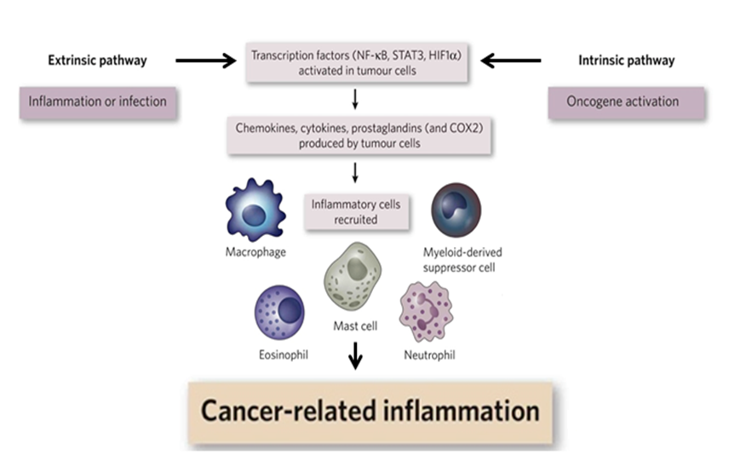
Humoral Innate Immunity
Cellular Innate
Immunity
Complement / PTX3
(e.g. Mantovani, Sica, Allavena, Balkwill, Nature, 2008; Mantovani, Nature, 2009; Hanahan and Weinberg, Cell, 2000; Cell, 2011; Reis et al, Nature Rev Immunol, 2018; Bonavita et al, Cell, 2015)

Slide 10
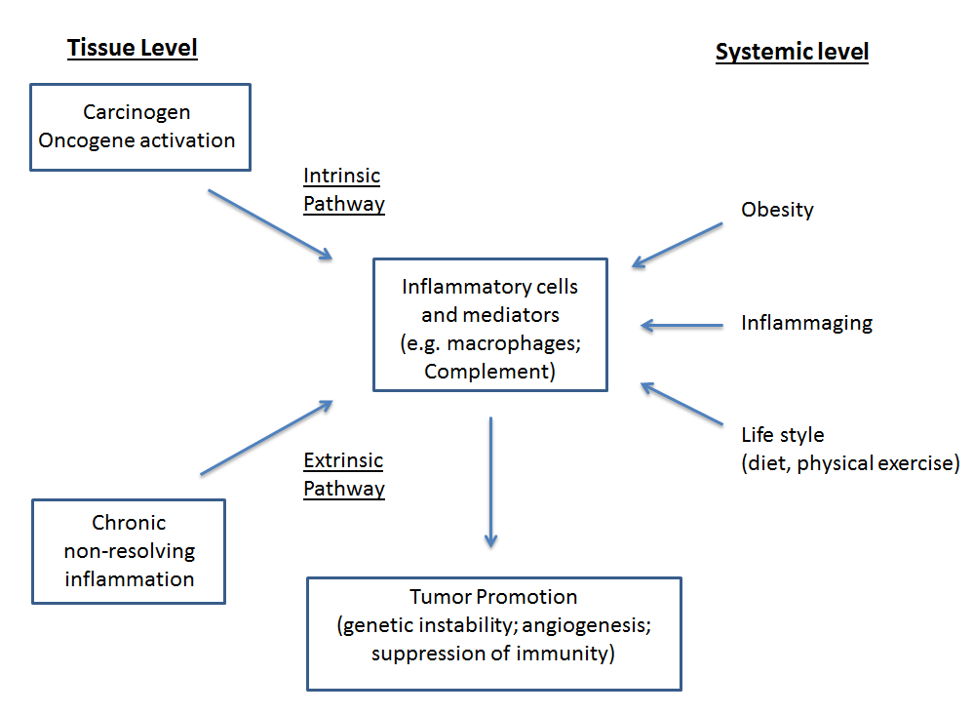
Pathways linking inflammation and cancer
Mantovani et al, Nature, 2008; Nature, Rev Clin. Immunol., 2017; Seminars Immunology, 2018

Slide 11

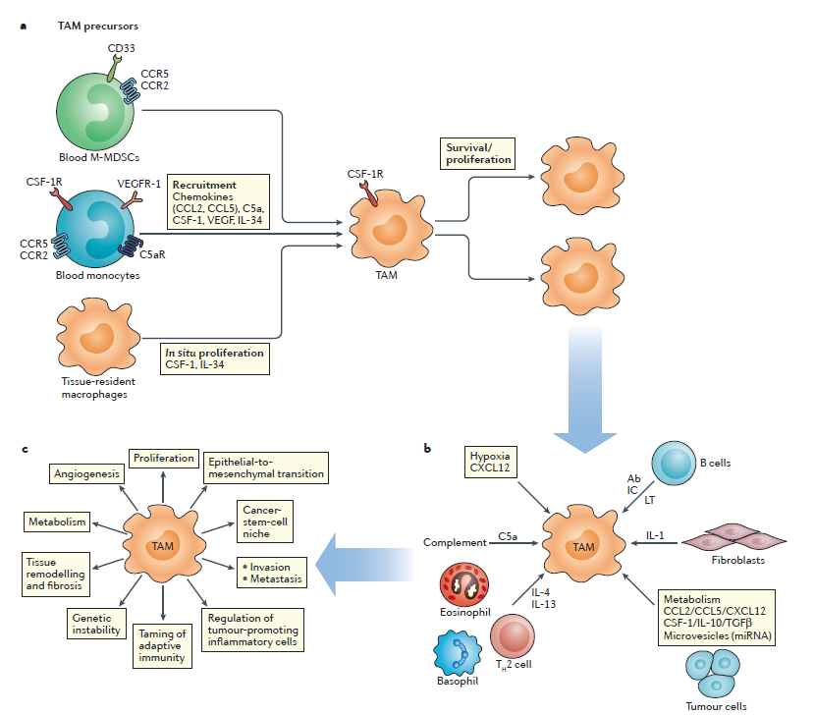
The role of TAMs in tumour progression
(Bottazzi et al J Immunol 1990)
M2, M2-like
Mantovani , Marchesi..Allavena, Nature Reviews Clinical Oncology, 2017
Notes:
A schematic representation of the role of tumour-associated macrophages (TAMs) in tumour progression.
<number>

Slide 12

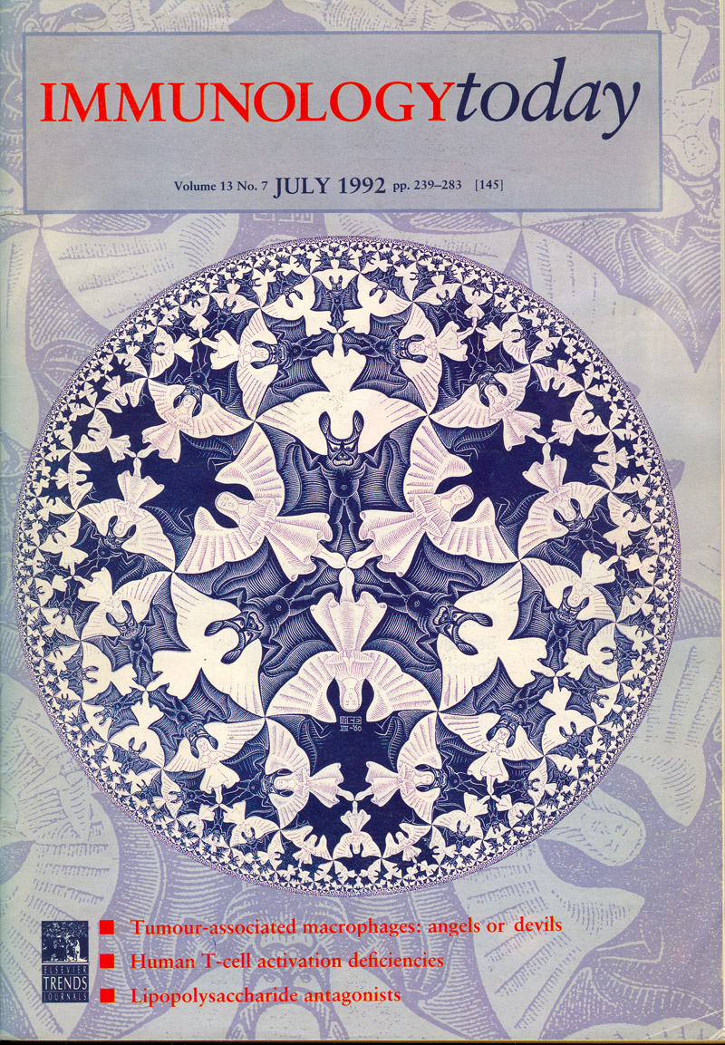
(Mantovani…. Ruco, Immunol Today 1992)

Slide 13
The role of TAMs in tumour progression
(Bottazzi et al J Immunol 1990)
M2, M2-like
(Mantovani , Marchesi..Allavena, et al Nature Reviews Clinical Oncology, 2017)
Notes:
A schematic representation of the role of tumour-associated macrophages (TAMs) in tumour progression.
<number>

Slide 14
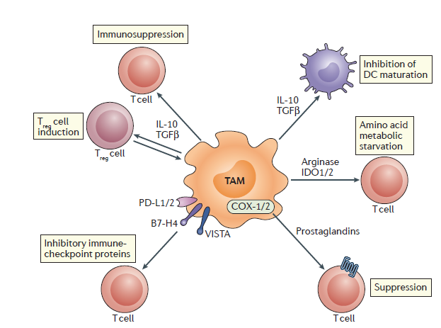
Mechanisms of TAM
mediated immune suppression
(Mantovani et al, Nature Rev Clin Oncology, 2017)
Notes:
Mechanisms of tumour-associated macrophage (TAM)-mediated immune suppression.
<number>

Slide 15
MPM
PD-L1
PD-1
T cell
mAb
PD-L1
PD-1
Tumor Promotion
PD-1
NK cell
PD-L1
TAM
Immune
Suppression
Legend
PD-1
PD-L1
Y anti – PD-1 mAb
(Ceresoli and Mantovani, Lancet Oncol., 2018)

Slide 16

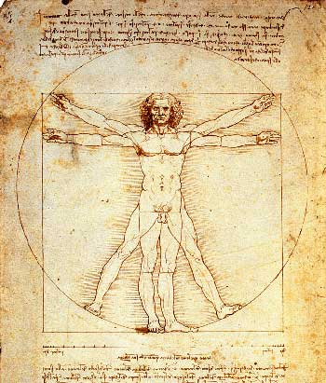
TAM, INFLAMMATION AND CANCER: TRANSLATION
Pathology: prognostic vs predictive
Prevention

Slide 17
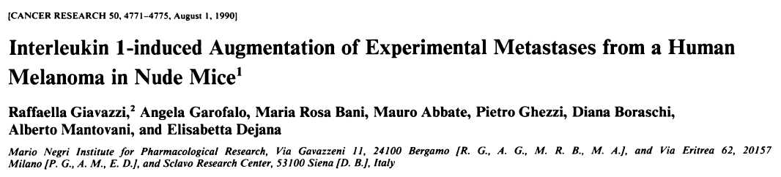
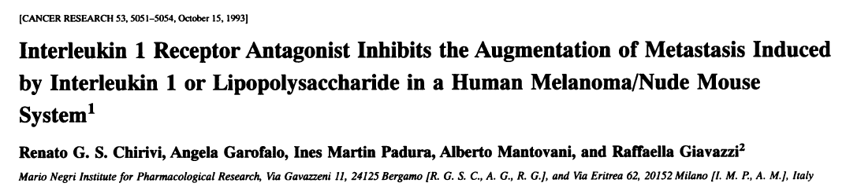
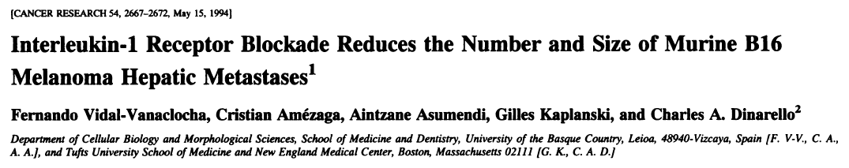
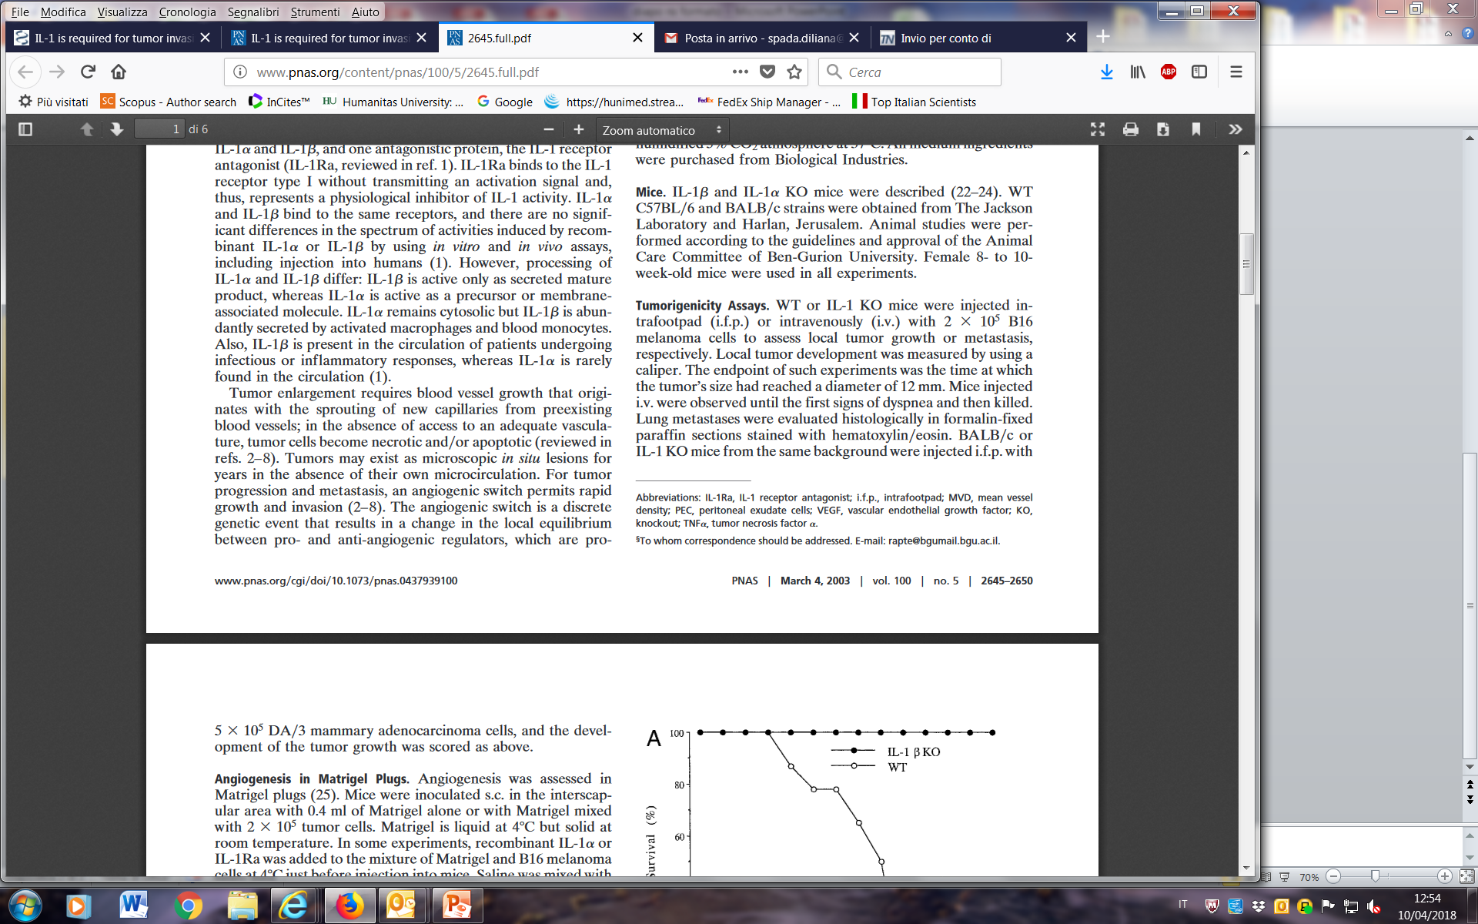
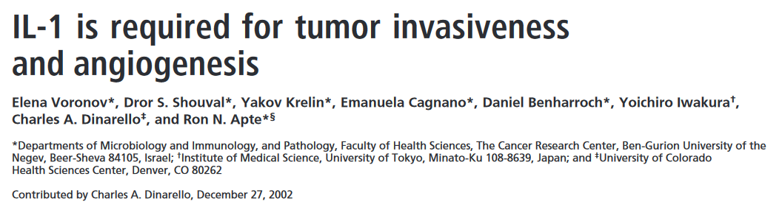

Slide 18
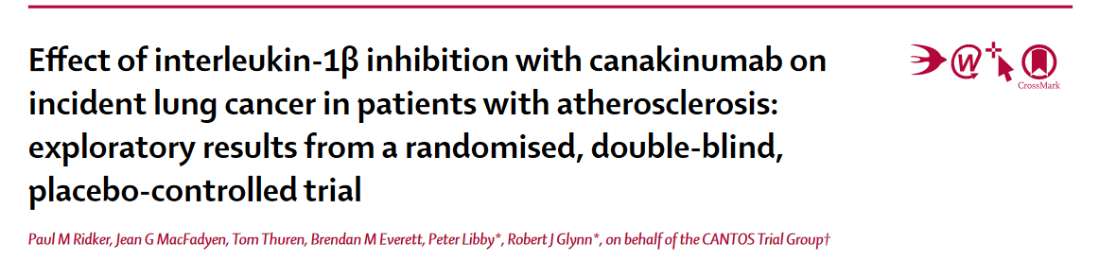
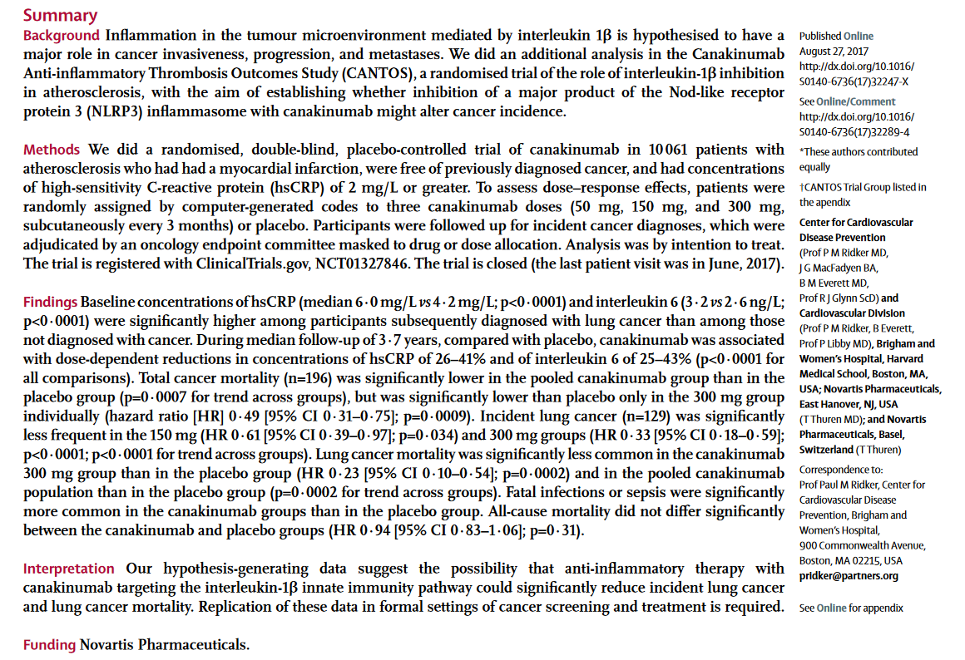

Slide 19
IL-1 in cancer related inflammation
Angiogenesis
Endothelial cell activation
Lymphoid cell polarization (Th17, ILC3)
MDSC
TAM and TAN
Tissue damage
Inflammasome activators (e.g. asbestos)
Microbial components
Suppression of adaptive immunity
Tumor progression
Metastasis
Sensors
IL - 1α
IL - 1β
Inflammasomes
TLR
Mantovani et al, Immunol Rev, 2018; Seminars Immunol, 2018

Slide 20


TAM, INFLAMMATION AND CANCER: TRANSLATION
Pathology: prognostic vs predictive
Prevention
Therapy: reeducation and targeting corrupted policemen

Slide 21
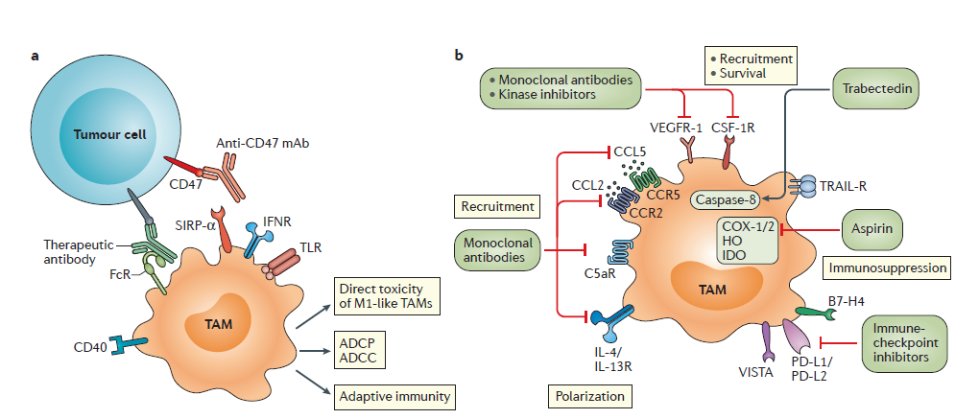
Macrophage-targeting antitumour treatment approaches
Trabectedin approved by FDA and EMA,
Germano et al Cancer Cell 2013; Chemo
and macrophage targeting in one molecule
Mantovani et al, Nature Rev Clin Oncol, 2017
Notes:
<number>

Slide 22

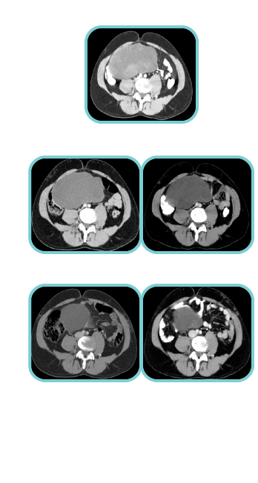
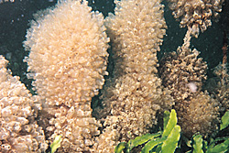
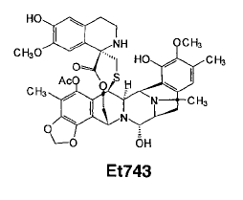
Clinical patterns of response to Trabectedin: Chemo and more
Atypical pattern of response
Classical pattern
Pre-treatment
Pre-treatment
Cycle 2
Cycle 1
Cycle 5
Pre-treatment
Cycle 3
Cycle 8
Cycle 11
TRABECTEDIN
Adapted from F. Grosso et al, Lancet Oncology 2007

Slide 23
Macrophage-targeting antitumour treatment approaches
Trabectedin approved by FDA and EMA,
Germano et al Cancer Cell 2013; Chemo
and macrophage targeting in one molecule
Mantovani et al, Nature Rev Clin Oncol, 2017
Notes:
<number>

Slide 24

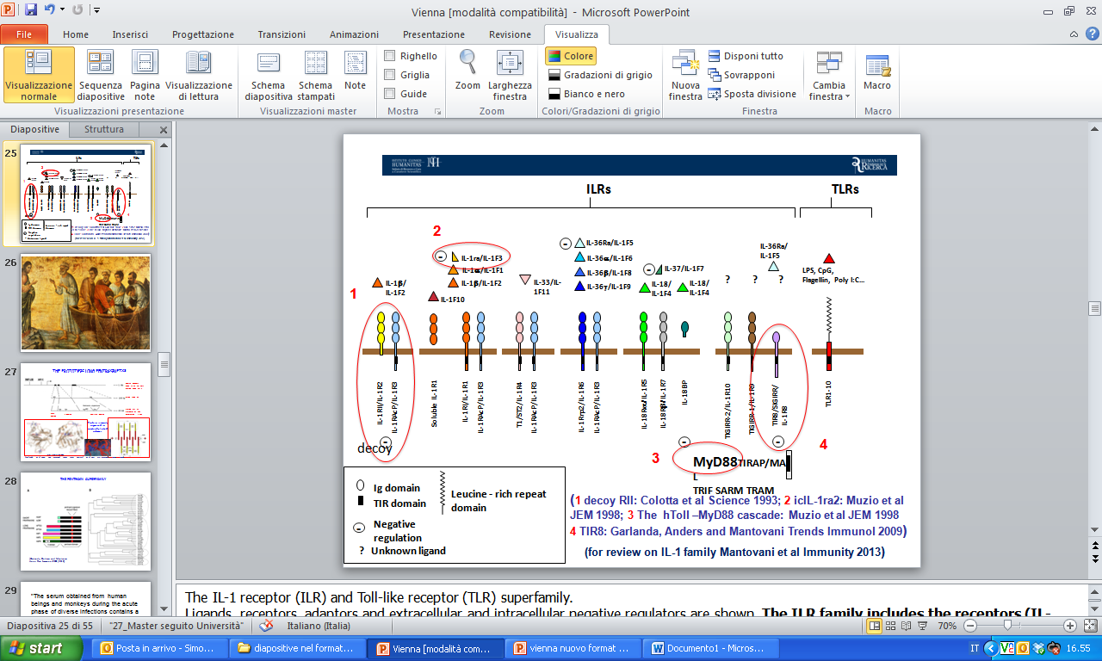
THE IL-1 RECEPTOR (ILR) FAMILY
(for a review on IL-1/IL-1R family: Garlanda, Dinarello and Mantovani, Immunity 2013)

Slide 25
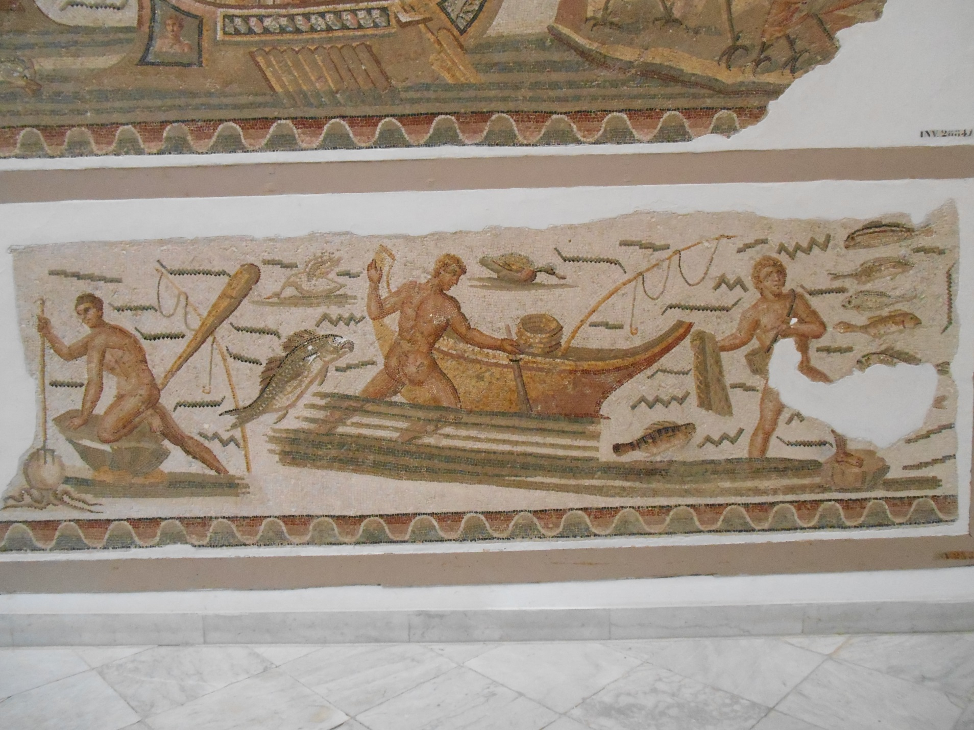
Bardo Museum, Tunis

Slide 26
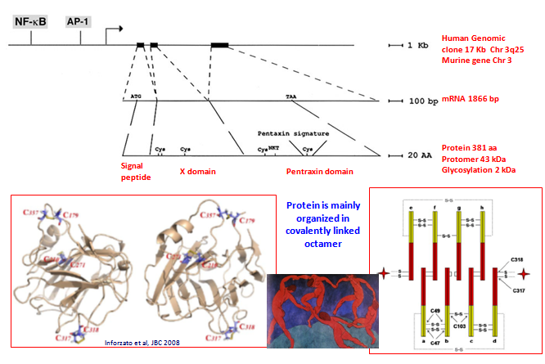
THE PROTOTYPIC LONG PENTRAXIN PTX3
C Reactive Protein
(Garlanda et al Annu Rev Immunol 2005, 2010; Bottazzi et al Curr Op Immunol, 2006, 2008, 2015; Immunol Rev 2017; Garlanda et al Physiol Rev 2017 in press)

Slide 27
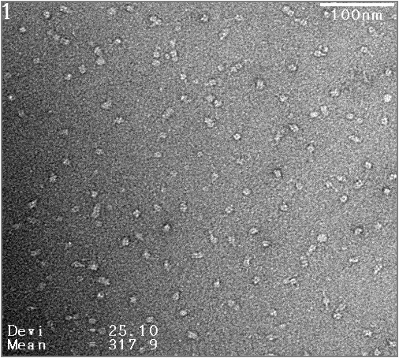
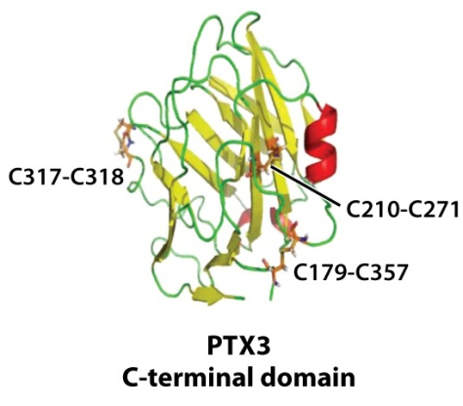

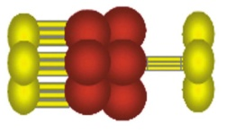
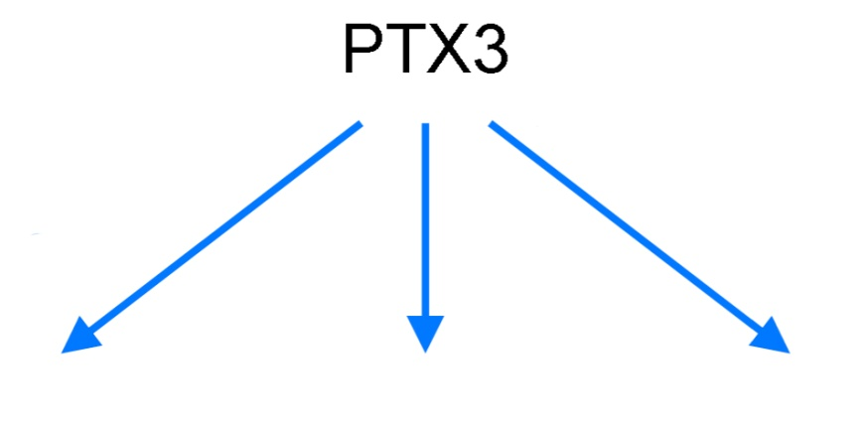
Chr 3q25
mRNA 1866 bp
Prot 381 aa
Ex 1
Ex 2
Ex 3
ASN220
SP NTD
PTX
PTX signature
(HxCxS/TWxS)
OmpA
Men B
components
C1q
Factor H
FcγR
Ficolins
MBL
P-selectin
Microbe recognition
Opsonization
C activation
and regulation of
inflammation
Repertoire
synergism
Regulation of
leukocyte
recruitment
and inflammation
RESISTANCE TO SELECTED MICROBES (eg A. fumigatus, P. aeruginosa) – REGULATION OF INFLAMMATION and REPAIR – ADAPTIVE IMMUNITY
Garlanda et al Nature 2002; Deban al Nature Immunol 2010; Lu et al Nature 2009; Bottazzi et al Annu Rev Immunol 2010;
Doni et al J Exp Med 2015; Bottazzi et al PLOSOne 2015; Chorny…Cerutti JEM 2016

Slide 28
PTX3 TRANSLATION - GENETICS
IN HUMANS GENETIC POLYMORPHISMS ASSOCIATED WITH SUSCEPTIBILITY TO INFECTION (TB+, P. AERUGINOSA*, UROPATHOGENIC E. COLI#, A.FUMIGATUS$)
_{* Chiarini, Genes Immun 2010}
_{+ Olesen, Genes Immun. 2007}
_{# Jaillon et al Immunity 2014}
$ Cunha et al New Engl J Med 2014

Slide 29
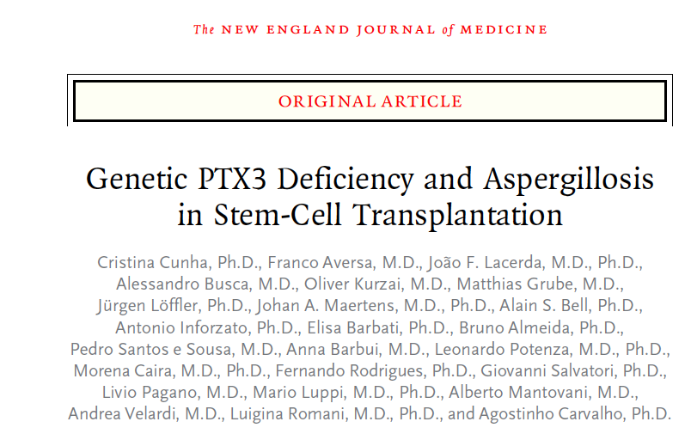
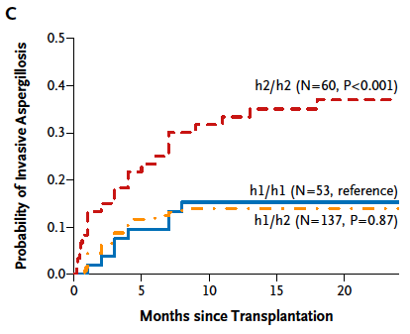
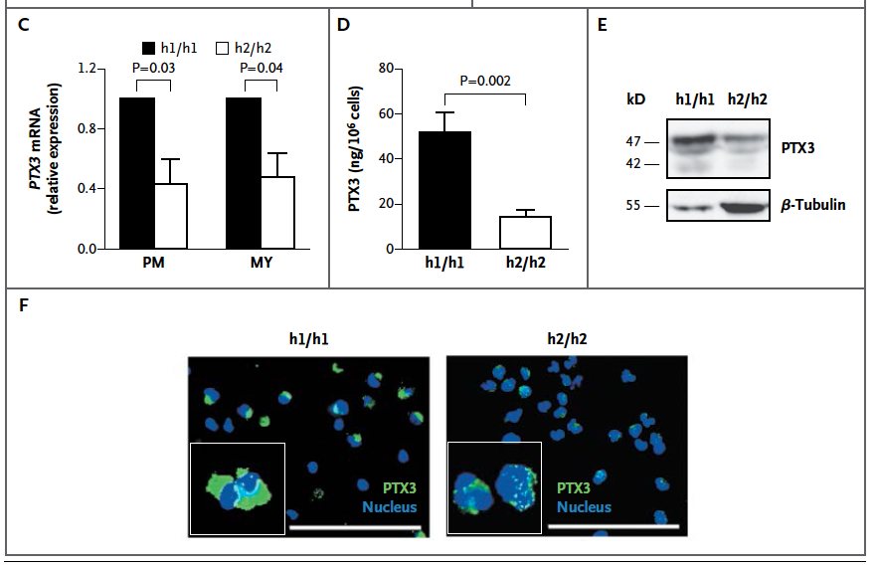
PTX3 polymorphisms were associated with susceptibility to A. fumigatus infection in patients undergoing hematopoietic stem cell transplantation
Haplotype AC was associated with increased protein expression
N Engl J Med. 2014 Jan 30;370(5):421-32.
Results confirmed and extended in 1,101 pts in the Swiss Organ Transplantation cohort (Wójtowicz A, et al, Clin Infect 2015), a lung transplantation cohort (Cunha et al 2015), 2,609 HCT pts at FHCR (Fisher et al Blood 2017), 185 chemo/mold pts (Brunel et al Haematologica 2018)

Slide 30
Increased susceptibility to carcinogenesis of PTX3^{-/-} mice
Bonavita et al. Cell 2015

Slide 31
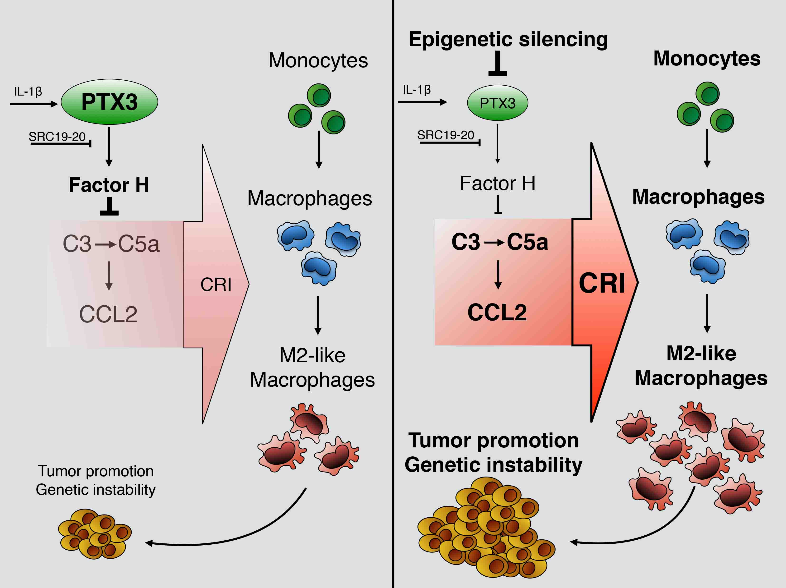
PTX3 as an extrinsic oncosuppressor in mouse and human cancer
Genetic or
Bonavita et al Cell 2015; Rubino et al Oncoimmunology 2017; Reis et al Nature Rev Immunol. 2018

Slide 32

C3 deficiency protects against
sarcoma tumor growth and metastasis
[transplanted MN/MCA1– sc injection]
(Magrini et al unpublished)
*p < 0.05, **p < 0.01, ns=not significant, t test
Notes:
<number>

Slide 33
Macrophage polarization in C3 deficient mice
[trasplantable sarcoma tumor model – im injection]
Mono
Mφ
M2-like
M1-like associated molecules
Notes:
<number>

Slide 34
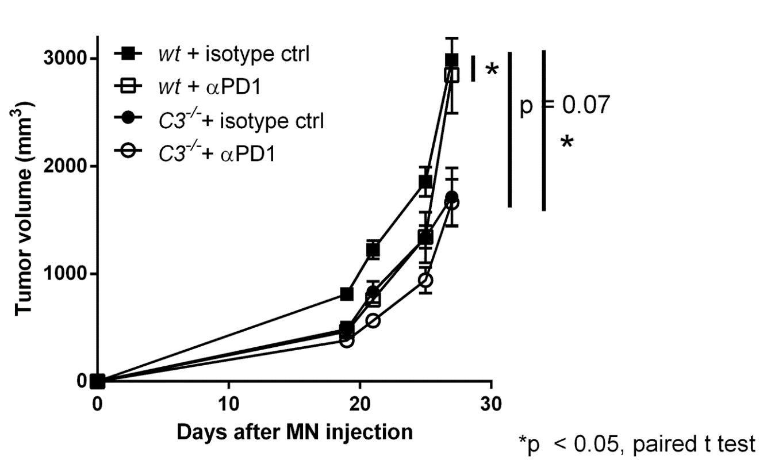
Increased anti-metastatic activity of anti-PD1 in C3 deficient mice
[trasplantable sarcoma tumor model – im injection]
1ary tumor
Lung metastasis
(Magrini et al unpublished)

Slide 35
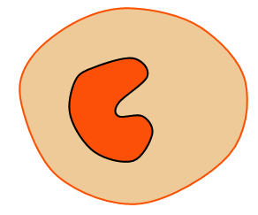
Complement and PTX3 in 3-MCA carcinogenesis and selected human tumors (e.g. CRC)
PTX3 (extrinsic
oncosuppressor)
Complement
FH-PTX3
+
Tumor promotion
TAM
T
-
Recruitment
-
M2-like
T
Inhibition of
Immunotherapy
Bonavita et al, Cell, 2015; Magrini et al unpublished;
Reis et al, Nature Rev Immunol, 2018

Slide 36
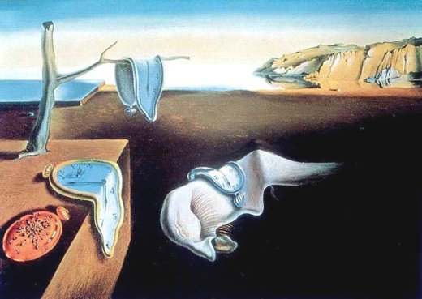

Slide 37
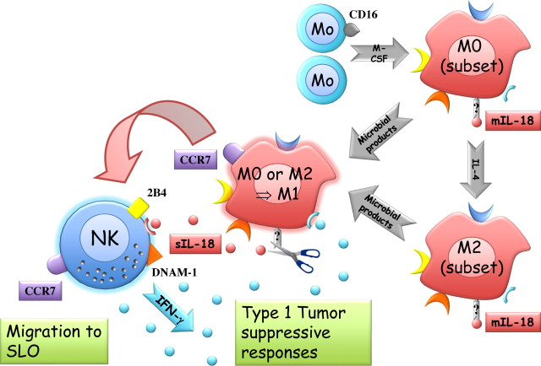
M0
M2
Modified from review Bottino C. et al Immunol Lett. 2014;
Originals: Bellora et al, PNAS, 2010; Eur J Immul, 2012 and 2014

Slide 38
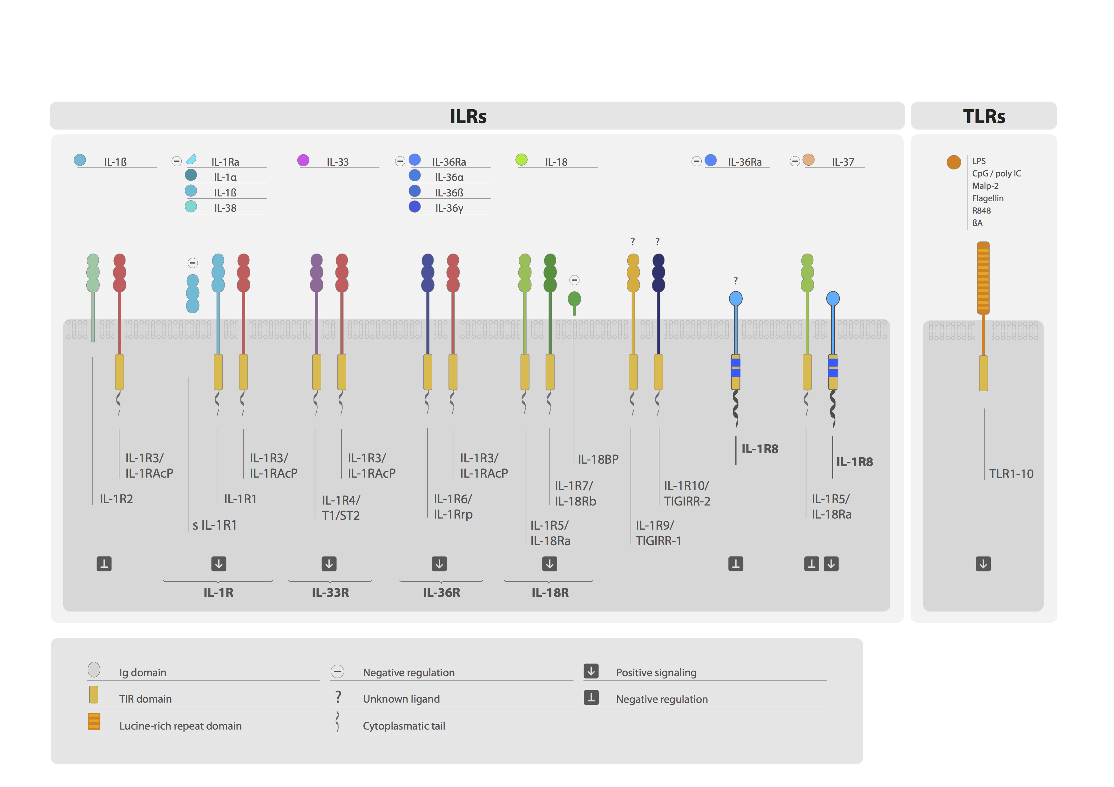
IL-1R8/TIR8/SIGIRR
A member of the IL-1 receptor family, with regulatory function
IL-1
IL-33
IL-36
IL-18
IL-37
TLR ag
(for a review on IL-1/IL-1R family: Garlanda, Dinarello and Mantovani, Immunity 2013,
Molgora et al Front. Immunol 2016; for IL-37R: Li et al PNAS; Nold-Petri et al Nature Immunol 2016)
Notes:
<number>

Slide 39
IL-1R8/TIR8/SIGIRR
A member of the IL-1 receptor family, with regulatory function
IL-1
IL-33
IL-36
IL-18
IL-37
TLR ag
(for a review on IL-1/IL-1R family: Garlanda, Dinarello and Mantovani, Immunity 2013,
Molgora et al Front. Immunol 2016; for IL-37R: Li et al PNAS; Nold-Petri et al Nature Immunol 2016)
Notes:
<number>

Slide 40
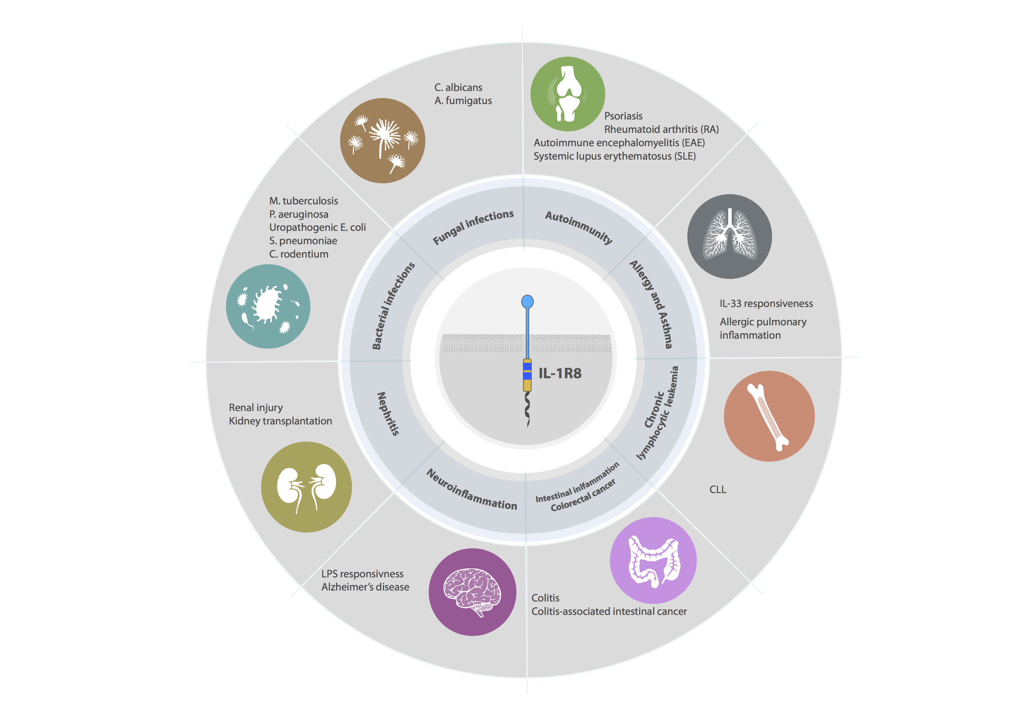
IL-1R8/TIR8/SIGIRR
IL-1R8, a negative regulator balancing amplification of immunity and tissue damage
IL-1R8 is expressed in:
Kidney
Liver
Lung
Intestinal tract
Immune cells:
Lymphocytes
Monocytes
DCs
Macrophages
NK cells
(for review on IL-1/IL-1R family: Garlanda, Dinarello and Mantovani, Immunity 2013; Molgora et al Front Immunol 2016)
Notes:
<number>

Slide 41
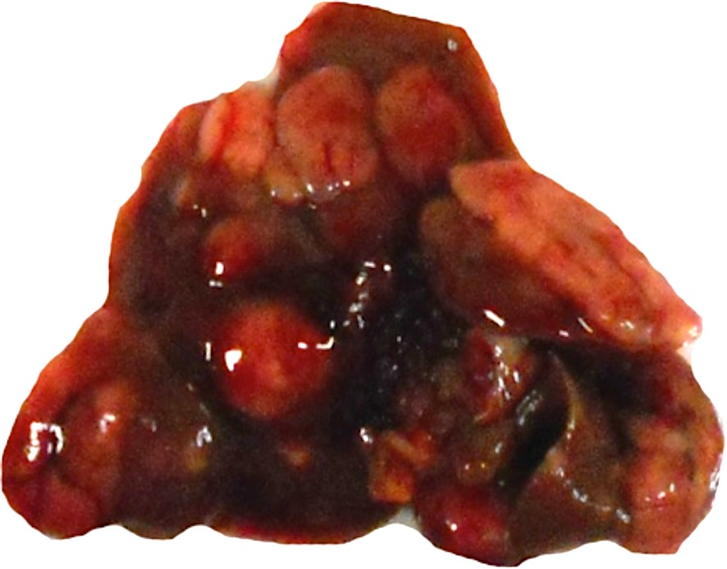
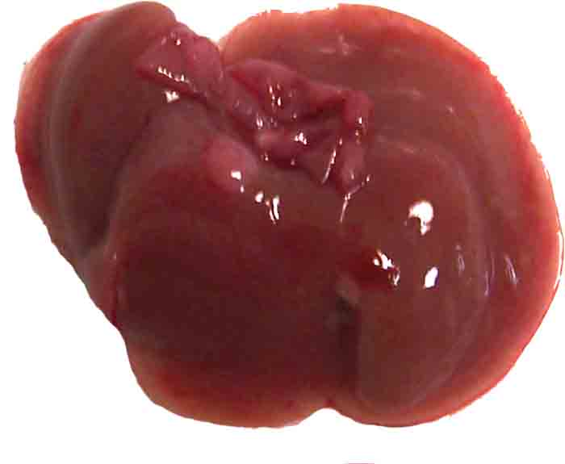




IL-1R8-deficient mice are protected against HCC development
Model of DEN-induced hepatocellular carcinoma (HCC)
DEN-induced liver cancerogenesis
NK cell infiltrate in the liver
6 Months
8-10 Months
12 Months
Il1r8^{+/+}
Il1r8^{-/-}
Il1r8^{+/+}
Il1r8^{-/-}
Il1r8^{+/+}
Il1r8^{-/-}
(Molgora, Bonavita et al, Nature 2017)
Notes:
<number>

Slide 42





NK cells express high levels of IL-1R8
HUMAN protein expression
ISOTYPE
aIL-1R8
Polentarutti N. et al, Eur. Cytokine Netw. (2003)
HUMAN
mRNA expression
MURINE
mRNA expression
(Molgora, Bonavita et al Nature 2017)

Slide 43

IL-1R8-deficiency is associated with higher
IFN-γ production and cytotoxic potential
IFN-γ
Granzyme B
Fas Ligand
DNAM-1, Ly49H, NKG2D
(Molgora, Bonavita et al Nature 2017)

Slide 44


IL-1R8 modulates IL-18 dependent NK cell activation
Macrophages
Dendritic cells
IL-18
IFN-γ
(Molgora, Bonavita et al, Nature 2017)

Slide 45

Responsiveness to IL-18 was dramatically different
in IL-1R8^{-/-} NK cells (RNAseq)
Untreated
IL-18
Some enriched pathways in
Il1r8^{-/-} NK:
p38 MAPK , MAPK
Leukocyte degranulation
Cytokine chemokine production
ICAM1, CD69…..
logFC
Il1r8^{+/+}
Il1r8^{-/-}
Il1r8^{+/+}
Il1r8^{-/-}

Slide 46
IL-1R8-deficiency significantly reduced
colorectal cancer-derived liver metastasis
Model of colon carcinoma (MC38 cell line)-derived liver metastasis
Liver metastasis
NK cell number
NK cell maturation
NK cell activation
(Molgora, Bonavita et al, Nature 2017)
Notes:
To adress the relevance of this data we have studied
<number>

Slide 47
IL-1R8-deficiency significantly reduced sarcoma-derived lung metastasis
Model of MCA-derived sarcoma metastasis
Primary tumor
NK cells in the lung
Lung metastasis
Depletion of NK cells
(Molgora, Bonavita et al, Nature 2017)
Notes:
To adress the relevance of this data we have studied
<number>

Slide 48

IL-1R8 AS A KEY REGULATOR (CHECKPOINT) OF NK CELL DIFFERENTIATION AND FUNCTION
_{Molgora, Bonavita} _{et al,} _{Nature, 2017}
See also Serhan…..Miller, Cancer Immunol Res, 2018;
Treg/IL-37- IL-1R8/ NK

Slide 49

High IL-1R8 expression is associated with a non-T/NK cell inflamed molecular signature in primary breast tumors
Campesato …..Camargo. Oncotarget 2017
Notes:
Figure 5
<number>

Slide 50



The Yin Yang of IL-1R8 in carcinogenesis and metastasis
IL-1R8 (TIR8/SIGIRR)
-
ORGAN IMMUNOLOGICAL CONTEXT
Tumor promoting INFLAMMATION
CHECKPOINT IN NK CELLS
UNLEASHED NK CELLS CAN MEDIATE RESISTANCE
AGAINST SOLID TUMORS AT NK RICH ANATOMICAL SITES
(Molgora, Bonavita
et al Nature 2017)
Notes:
<number>

Slide 51

Acknowledgements
Lab. of Experimental Immuno-pathology
Humanitas Research Hospital
Biobank
Humanitas Research Hospital
Humanitas Research Hospital
Cecilia Garlanda
Martina Molgora
Eduardo Bonavita
Andrea Ponzetta
Marialuisa Barbagallo
Nadia Polentarutti
Sébastien Jaillon
Federica Riva
Elena Magrini
Fabio Pasqualini
Marco Erreni
Marinos Kallikourdis
Giuliana Roselli
Barbara Cassani
Francesca Ficara
Rosita Rigoni
Stefania Vetrano
Massimo Locati
Domenico Mavilio
Daniela Pistillo
Department of Histology and Embryology
University of Rijeka (Croatia)
Stipan Jonjic
Branka Popovic
Dep. of Molecular Medicine
University “La Sapienza” Rome
Santiago Zelenay
Manchester
Angela Santoni
Giorgia Benigni
Giovanni Bernardini

Slide 52

_{San Gerolamo in meditazione}
Michelangelo Merisi detto il Caravaggio
Museo del Monasterio de Santa Maria, Montserrat, 1605 circa

Slide 53






HIIS 2009-2014; Phii 2015-2020

Slide 54



Notes:
<number>

