Slide 1
IUPHAR/BPS Guide to PHARMACOLOGY Generic slides for use in presentations and teaching materials
These slides are provided for public use to facilitate the production of teaching materials and presentations describing the IUPHAR/BPS Guide to PHARMACOLOGY (www.guidetopharmacology.org).
The slide set is divided up into sections which can be mixed and matched as required.
They are provided under the CC BY license allowing you to adapt and use them for any purpose as long as we are acknowledged as the original authors.
The data described herein are current as of December 2017.
These slides are available to download as a Microsoft PowerPoint file at http://www.guidetopharmacology.org/slides/GtoPdb_Generic_Slides.pptxand a PDF at http://www.guidetopharmacology.org/slides/GtoPdb_Generic_Slides.pdf
They are also available on SlideShare at https://www.slideshare.net/GuidetoPHARM/gtopdb-generic-slides-201718

Slide 2
The IUPHAR/BPS Guide to PHARMACOLOGY (GtoPdb)
http://www.guidetopharmacology.org
Name
Date, Venue

Slide 3
Contents
Background and history of the database
About NC-IUPHAR
Database content
Navigating the website and search tools
Recent additions and expansions
The Concise Guide to PHARMACOLOGY
The IUPHAR Guide to IMMUNOPHARMACOLOGY
The IUPHAR/MMV Guide to MALARIA PHARMACOLOGY
Additional features and resources
The Pharmacology Education Project
Acknowledgements

Slide 4
Background and history of the database

Slide 5
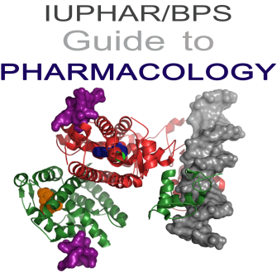
Introducing GtoPdb (1)
In early 2011 a collaboration was initiated between The International Union of Basic and Clinical Pharmacology (IUPHAR) and the British Pharmacological Society
Aim: to develop a single entry point to information on pharmacological targets and their ligands

Slide 6
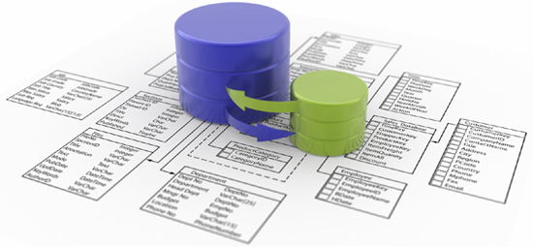
Introducing GtoPdb (2)
A single entry point to previously separate but complementary information originally contained in the IUPHAR database (IUPHAR-DB) and the Guide to Receptors and Channels (GRAC) series of publications

Slide 7
Remit of GtoPdb
GtoPdb aims to:
Provide access to data on all known biological targets
Make recommendations on ligands for use in characterising those targets
Provide an entry point into the pharmacological literature
Provide an integrated educational resource with high quality training in the principles of basic and clinical pharmacology and techniques
Foster innovative drug discovery

Slide 8
A brief history of IUPHAR-DB
Development of the IUPHAR database of receptors and channels began in 2000
Developed by a team of curators, guided by the IUPHAR Committee on Receptor Nomenclature and Drug Classification (NC-IUPHAR) and its international network of expert subcommittees
In-depth coverage of the properties and pharmacology of G protein-coupled receptors, voltage- and ligand-gated ion channels, and nuclear hormone receptors.

Slide 9
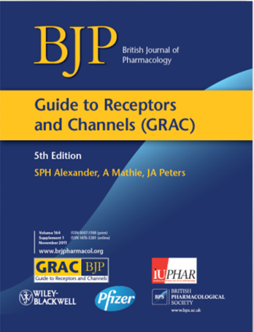
A brief history of GRAC
The Guide to Receptors and Channels (GRAC)
Published biennially since 2004 in the British Journal of Pharmacology
Provides a rapid overview of the key properties of a wide range of established or potential pharmacological targets
Information arranged succinctly, so that a newcomer to a particular target group can identify the main elements ‘at a glance’.

Slide 10
About NC-iuphar

Slide 11
About NC-IUPHAR
The International Union of Basic and Clinical Pharmacology Committee on Receptor Nomenclature and Drug Classification
Objectives:
Issue guidelines for the nomenclature and classification of human biological targets
Facilitate the designation of newly discovered sequences as functional biological targets and potential drug targets
Designate the polymorphisms and variants which are functionally important
Develop an authoritative and freely available, global online resource, the Guide to PHARMACOLOGY (http://www.guidetopharmacology.org)
NC-IUPHAR expert reviews:
Nomenclature articles published in Pharmacological Reviews
Articles and editorials on varied topics published in British Journal of Pharmacology
Cumulative H-Index for NC-IUPHAR is >70.
http://www.guidetopharmacology.org/nciuphar.jsp

Slide 12
NC-IUPHAR membership (1)
Executive Committee
Stephen Alexander, UK (Chair)
Arthur Christopoulos, Australia (Deputy Chair)
Anthony Davenport, UK (Funding Liaison)
Jamie A. Davies (Database Chair/PI)
Doriano Fabbro, Switzerland (Industry Liaison)
Adam Pawson, UK (Executive Secretary)
Core members
Stephen Alexander, UK
Arthur Christopoulos, Australia
John Cidlowski, USA
Anthony Davenport, UK
Doriano Fabbro, Switzerland
Kozo Kaibuchi, Japan
Yoshikatsu Kanai, Japan
Francesca Levi-Schaffer, Israel
Eliot Ohlstein, USA - Editor
John A. Peters, UK
Alex Phipps, UK
Joerg Striessnig, Austria
Ex Officio
Ingolf Cascorbi, Germany (IUPHAR President)
Michael Spedding, France (IUPHAR Secretary-General)
James Barrett, USA (IUPHAR Treasurer)
Amrita Ahluwalia, UK (BJP Ediotr-in-Chief)
Elspeth Bruford, UK (HGNC Group Coordinator)
Simon Maxwell, UK (Educational Site Project Leader)
Jamie A. Davies, UK (Database Chair/Principal Investigator)
Jane Armstrong, UK (Database Curator)
Elena Faccenda, UK (Database Curator)
Simon D. Harding, UK (Senior Database Developer)
Adam Pawson, UK (Senior Database Curator)
Past Chairs (ex officio)
Paul Vanhoutte, China
Robert Ruffolo, USA

Slide 13
NC-IUPHAR membership (2)
Corresponding members
Susan Amara, USA
Tom I. Bonner, USA
Michel Bouvier, Canada
Thomas Burris, USA
William A. Catterall, USA
Stephen Charlton, UK
Moses Chao, USA
Mark Coles, UK
Steven L. Colletti, USA
Graham Collingridge, UK
Philippe Delerive, France
Sir Colin T. Dollery, UK
Richard Eglen, UK
Sam J. Enna, USA
Steven Foord, UK
David Gloriam, Denmark
Gillian Gray, UK
Debbie Hay, New Zealand
Allyn Howlett, USA
Franz Hofmann, Germany
Yu Huang, Hong Kong
Ad P. Ijzerman, The Netherlands
Michael F. Jarvis, USA
Bong-Kiun Kaang, Korea
Terry Kenakin, USA
Janos Kiss, Hungary
Stefan Knapp, UK
Andrew Knight, UK
Chris Langmead, Australia
Vincent Laudet, France
Margaret (Mandy) MacLean, UK
Neil Marrion, UK
Fiona Marshall, UK
Alistair Mathie, UK
Ian McGrath, UK
Graeme Milligan, UK
Richard Neubig, USA
Stefan Offermanns, Germany
Richard Olsen, USA
Jean-Philippe Pin, France
Helgi Schiöth, Sweden
David Searls, USA
Graeme Semple, USA
Patrick M. Sexton, Australia
Joanna L. Sharman, UK
Christopher Southan, Sweden
Roland Staal, USA
Bart Staels, France
Georg Terstappen, Germany
Katerina Tiligada, Greece
Mary Vore, USA
Clinical Translational Pharmacology Group Ed Bullmore, UK
Robert Dow, UK
Garrett Fitzgerald, USA
Alex Phipps, UK
Patrick du Souich, Canada
David Webb, UK
Don Birkett, Australia

Slide 14
NC-IUPHAR subcommittees
NC-IUPHAR Subcommittee Chairs/Liaisons (96 subcommittees; >500 scientists) G protein-coupled receptors Subcommittees
5-Hydroxytryptamine: Nick Barnes, John Neumaier | Acetylcholine (muscarinic): Arthur Christopoulos | Adenosine: Adriaan Izjerman
alpha₁-adrenoceptors: Dianne Perez | alpha₂-adrenoceptors: VACANT | Angiotensin: Sadashiva Karnik
Apelin: Anthony Davenport | beta-adrenoceptors: Terry Hébert | Bile acid: Anthony Davenport
Bombesin: Robert Jensen | Bradykinin: VACANT | Calcitonin: Debbie Hay, David Poyner
Calcium-sensing: Ed Brown, Hans Bräuner-Osborne | Cannabinoid: Roger Pertwee, Allyn Howlett | Chemokine: Philip Murphy
Cholecystokinin: Laurence Miller | Complement peptide: Peter Monk | Corticotropin-releasing factor: Richard Hauger, Frank Dautzenberg
Dopamine: Raul Gainetdinov | Endothelin: Anthony Davenport | Estrogen (G protein coupled): VACANT
Formylpeptide family: Richard Ye | Free fatty acid: VACANT | Frizzled: Gunnar Schulte
GABA_{B}: Bernhard Bettler | Galanin: Andrew Gundlach | Ghrelin: Birgitte Holst
Glucagon receptor family: Laurence Miller | Glycoprotein hormone: Deborah Segaloff | Gonadotrophin-releasing hormone: Adriaan Ijzerman
Histamine: Paul Chazot | Hydroxycarboxylic acid: Stefan Offermanns | Kisspeptin: Anthony Davenport
Leukotriene: Magnus Bäck | Lysophospholipid (LPA): Jerold Chung | Lysophospholipid (S1P): Sarah Spiegel
Melanin-concentrating hormone: Jean-Louis Nahon | Melanocortin: Tung Fong, Helgi Schiöth | Melatonin: Ralf Jockers
Metabotropic glutamate: Jean-Philippe Pin | Motilin: Anthony Davenport | Neuromedin U: Gary Willars
Neuropeptide FF/neuropeptide AF: Jean-Marie Zajac | Neuropeptide S: Girolamo Calơ | Neuropeptide W/neuropeptide B: Anthony Davenport
Neuropeptide Y: Dan Larhammar | Neurotensin: Jean Mazella | Opioid: Larry Toll
Orexin: Christopher Winrow | P2Y: Maria-Pia Abbracchio | Parathyroid hormone: Jean-Pierre Vilardaga
Peptide P518: Jerome Leprince | Platelet-activating factor: VACANT | Prokineticin: Philippe Rondard
Prolactin-releasing peptide: Helgi Schiöth | Prostanoid: Xavier Norel | Protease-activated: Nigel Bunnett
Relaxin family peptide: Roger Summers | Relaxin-like: Nick Barker | Somatostatin: Stephan Schulz
Tachykinin: Susan Leeman, Steven Douglas | Trace amine: Janet Maguire | Thyrotropin-releasing hormone: Marvin Gershengorn
Urotensin: Hubert Vaudry | Vasopressin and oxytocin: Bernard Mouillac | VIP and PACAP: VACANT
Ligand-gated ion channels Subcommittees John Peters (Liaison for all LGIC subcommittees) | Voltage-gated ion channels Subcommittees Joerg Striessnig (Liaison for all VGIC subcommittees) | Nuclear hormone receptors Subcommittees John Cidlowski and Thomas Burris (Liaisons for all NHR subcommittees
5-HT₃: John Peters GABA_{A}: Richard Olsen Glycine: Joseph Lynch Ionotropic glutamate: Graham Collingridge Nicotinic acetylcholine: Neil Millar P2X: Charles Kennedy ZAC: Timothy Hales Antibodies Subcommittee Alex Phipps Adenylyl cyclases Subcommittee Carmen Dessauer Drug Target and Chemistry Curation Subcommittee Christopher Southan Epigenetics Subcommittee Rabinder Prinjha | Calcium-activated potassium: George Gutman CatSper and Two-Pore: David Chapman Cyclic nucleotide-regulated: Martin Biel Inwardly rectifying potassium: Yoshihiro Kubo Transient Receptor Potential: David Clapham Two-P potassium: Steven Goldstein Voltage-gated calcium: William Catterall Voltage-gated potassium: George Gutman Voltage-gated sodium: William Catterall Gasotransmitters Subcommittee Andreas Papapetropoulos and Csaba Szabo Guanylyl cyclases Subcommittee Adrian Hobbs and Scott Waldman Non-coding RNAs Subcommittee Andrew Baker | NHR subcommittees are currently being reformed Kinases Subcommittee Doriano Fabbro Pattern Recognition Receptors Subcommittee Clare Bryant Proteases Subcommittee Anthony Turner Transporters Subcommittee Stephen Alexander ‘Concise Guide to PHARMACOLOGY’ Editors Stephen Alexander, Eamonn Kelly, Neil Marrion, John Peters

Slide 15
Database content

Slide 16
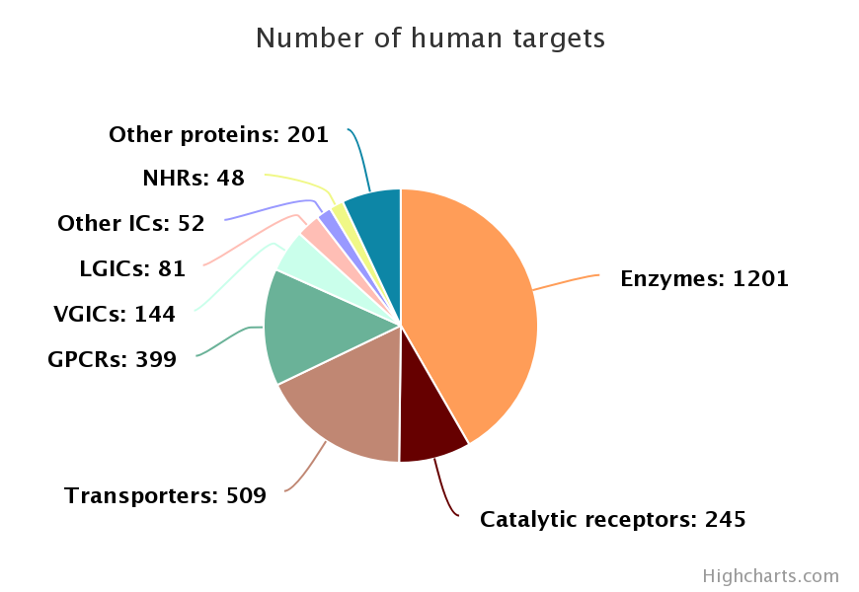
GtoPdb content - targets
>1,700 established or potential drug targets and ~1,100 related proteins:
G protein-coupled receptors (Class A, B, C, frizzled, adhesion and orphan GPCRs)
Ligand-gated ion channels
Voltage-gated ion channels
Other ion channels
Nuclear hormone receptors
Catalytic receptors
Kinases
Proteases
Other enzymes
Transporters
Other protein targets
Target numbers as of the 2018.4 release

Slide 17
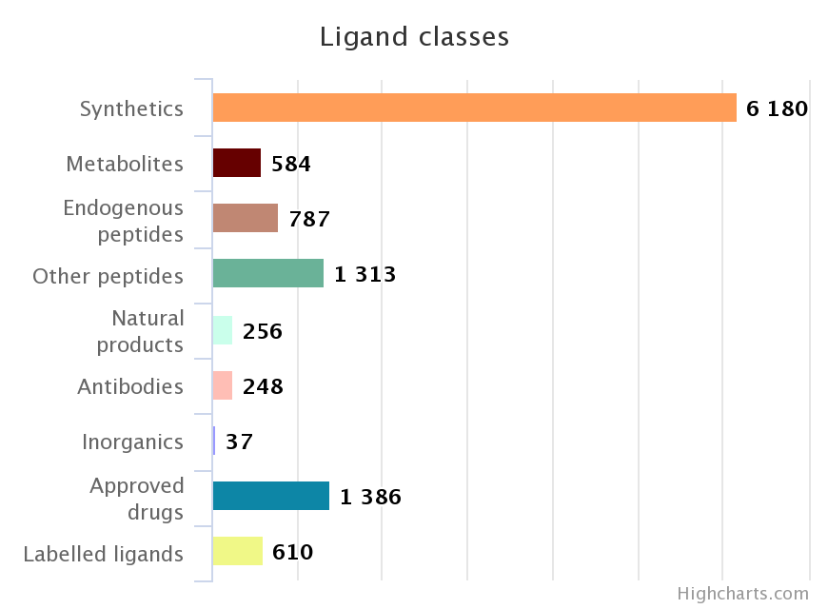
GtoPdb content - ligands
~9,000 ligands and drugs:
Approved drugs
Synthetic organic compounds
Metabolites, hormones, neurotransmitters
Natural products
Endogenous peptides
Other peptides
Inorganics
Antibodies
Labelled ligands
Ligand numbers as of the 2018.4 release

Slide 18
Concise target family summaries
Concise target family summaries introducing the main properties
Expert overviews and comments
“Gold-standard” selective ligands, clinically-used drugs, endogenous ligands and probes (radioligands and PET ligands where available)
Further reading lists

Slide 19
Detailed annotation for selected targets
Data are collected and reviewed by NC-IUPHAR subcommittees and individual experts:
Gene and protein information
IUPHAR nomenclature and synonyms
Extensive pharmacology: agonist, antagonist and allosteric regulator affinities, ion channel blockers, enzyme/transporter inhibitors and substrates
Signal transduction mechanisms; Tissue distribution
Functional assays; Physiological functions
Mouse gene knockout phenotypes
Clinically-relevant mutations and pathophysiology
Gene expression changes in disease; Biologically significant variants

Slide 20
Other features
Extensively referenced and linked to primary literature in PubMed
Focus is on human data but where species differences exist or literature data unavailable other species are given
Linked to corresponding entries in other resources, e.g. UniProt, Ensembl, Entrez Gene, KEGG, OMIM, ChEMBL
Ligand information including structure, peptide sequences, clinical data and nomenclature, linked up to chemistry resources including PubChem

Slide 21
Navigating the website and search tools

Slide 22
Navigating GtoPdb
Browse lists of targets and ligands
Target families are listed under expandable family trees
Target information is presented in two levels of detail
Concise family summary pages
Detailed pages for selected targets
Ligand pages are provided for all compounds in GtoPdb
Use the search tools to search by name, keyword, identifier or ligand structure
Notes:
You may wish to switch to a live demo here. The following slides can be used in place of a demo.

Slide 23
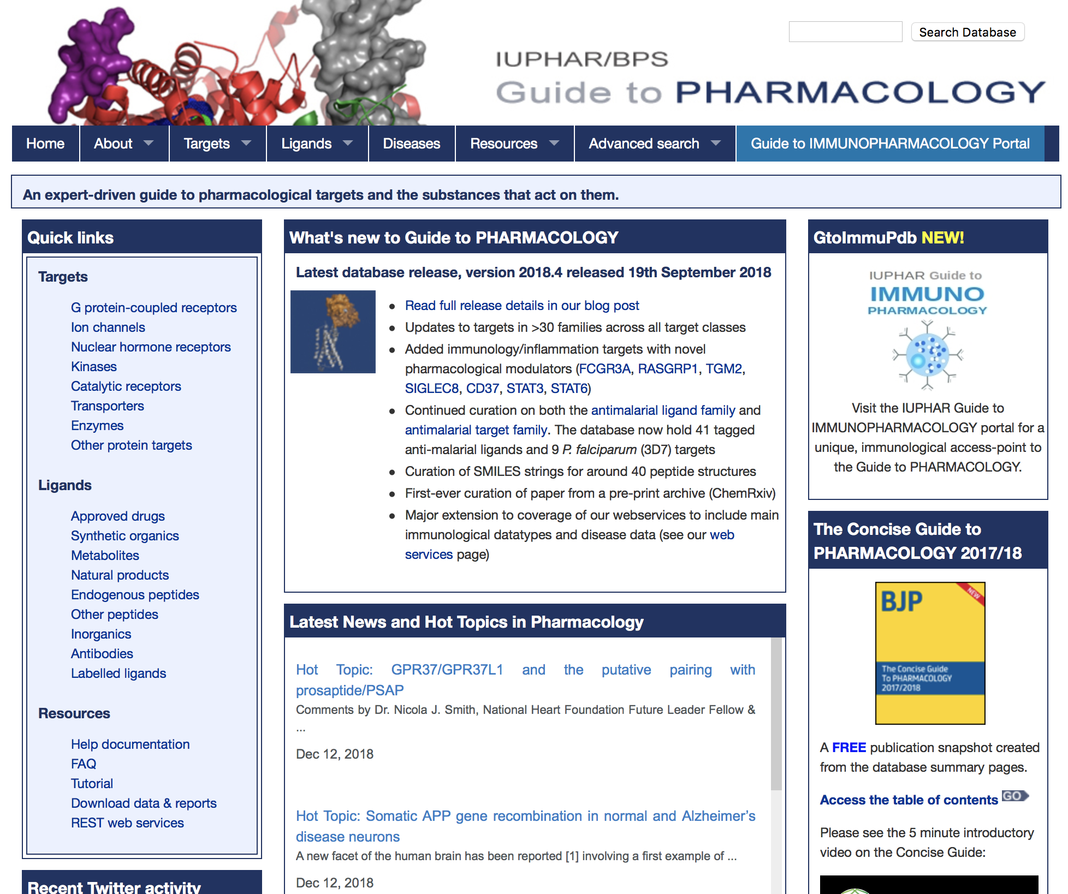
GtoPdb home page

Slide 24
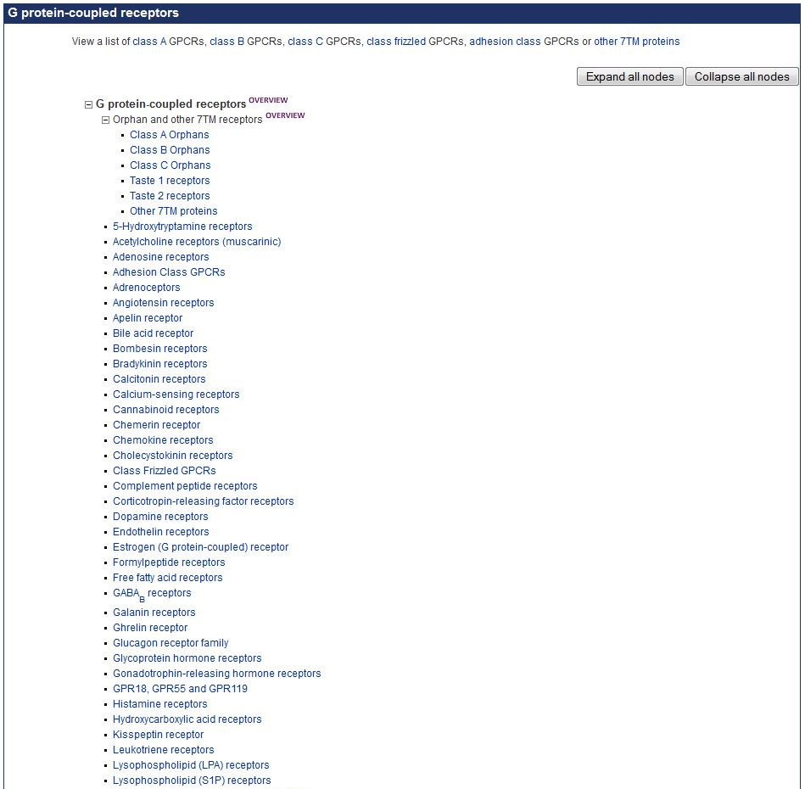
GtoPdb home page

Slide 25
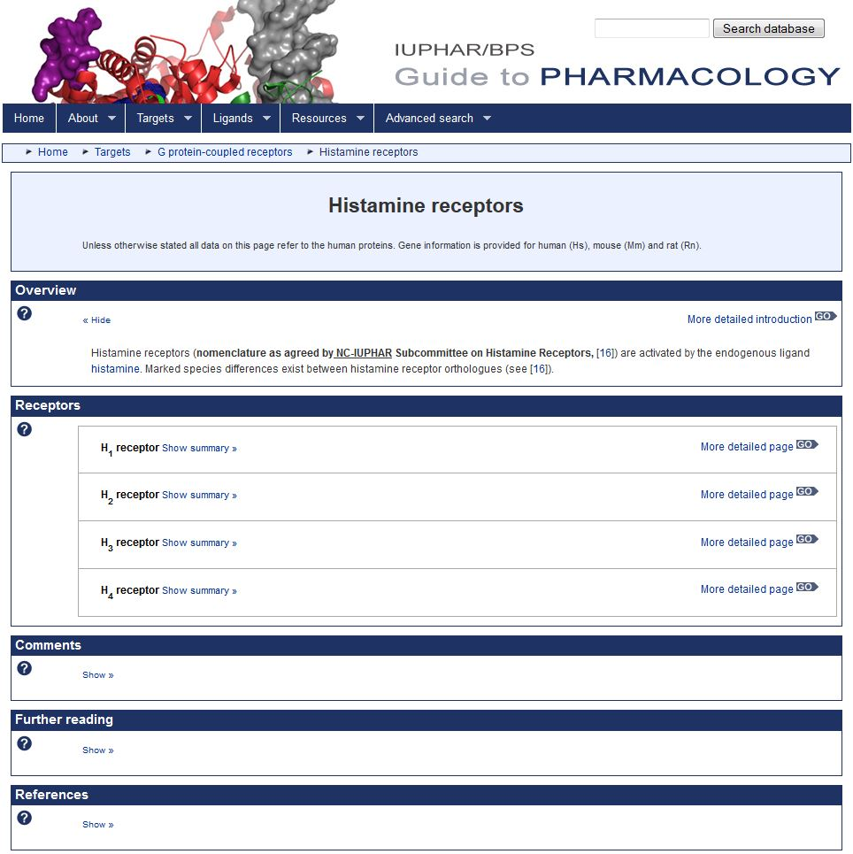
Histamine receptors family summary page

Slide 26
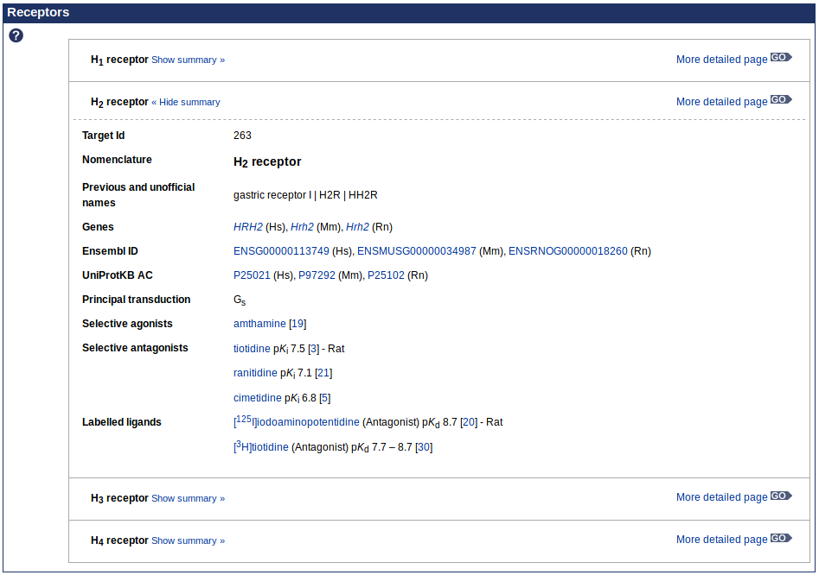
Histamine H₂ receptor concise summary view

Slide 27
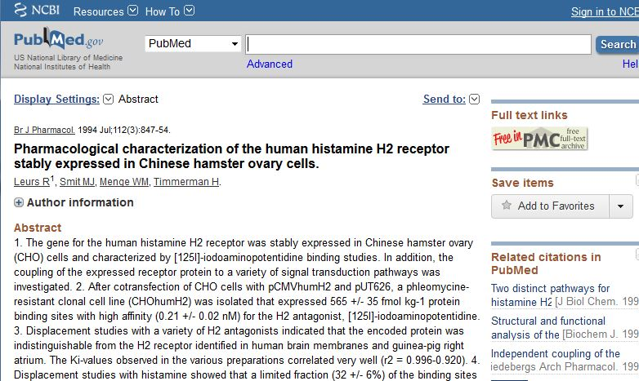
Reference information and linkout to PubMed

Slide 28
Link to more details for the H₂ receptor

Slide 29
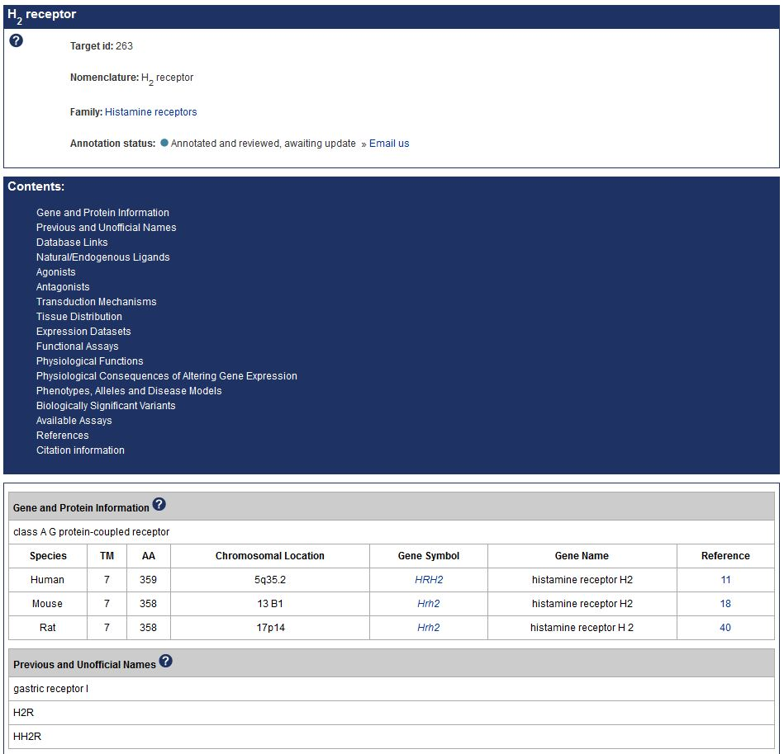
H₂ receptor detailed annotation page

Slide 30
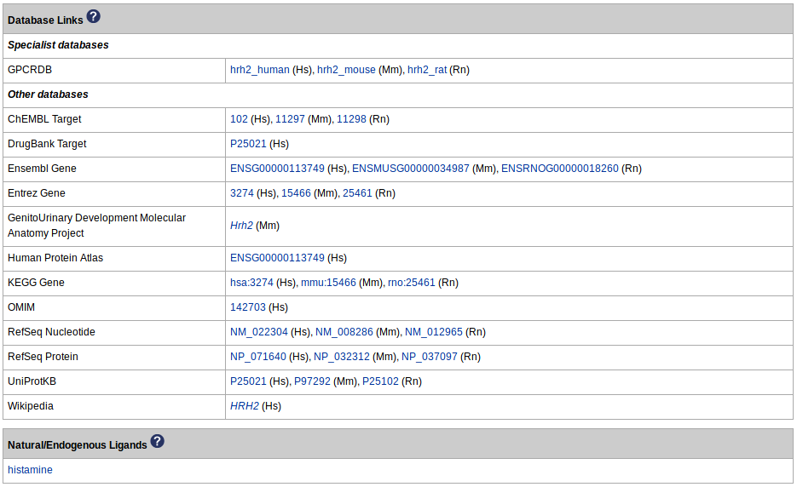
Linkouts to other gene and protein resources

Slide 31
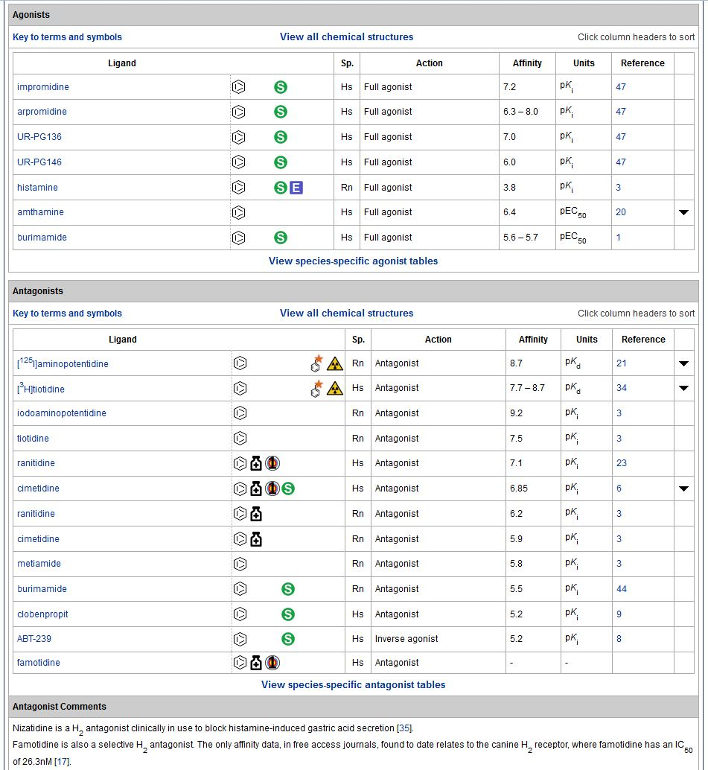
Interaction tables
Click for species-specific selectivity table
Ligand is endogenous in this species
Ligand is labelled
Ligand is radioactive
Approved drug
Primary target of this compound

Slide 32
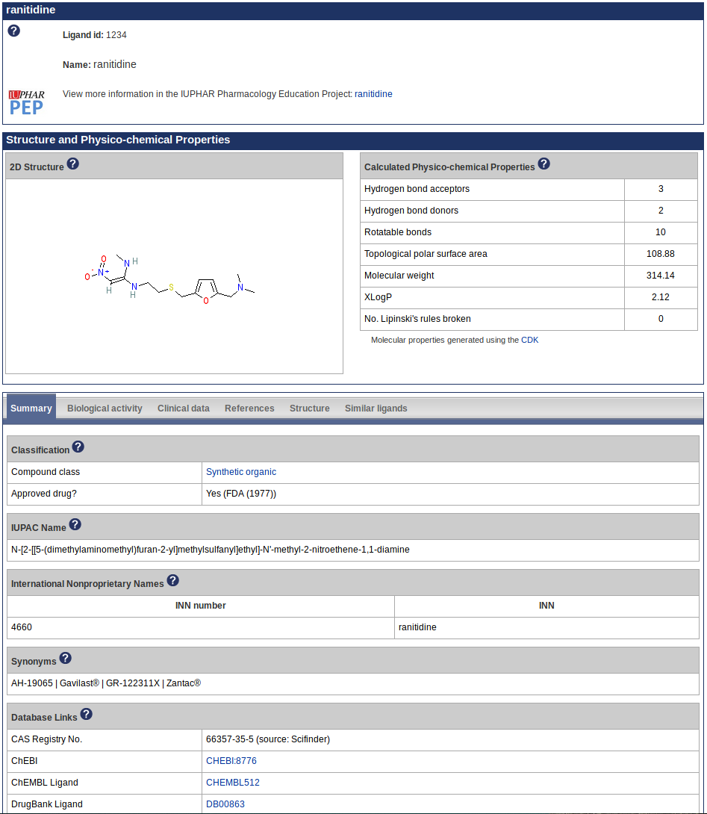
Ligand page for the approved drug ranitidine

Slide 33
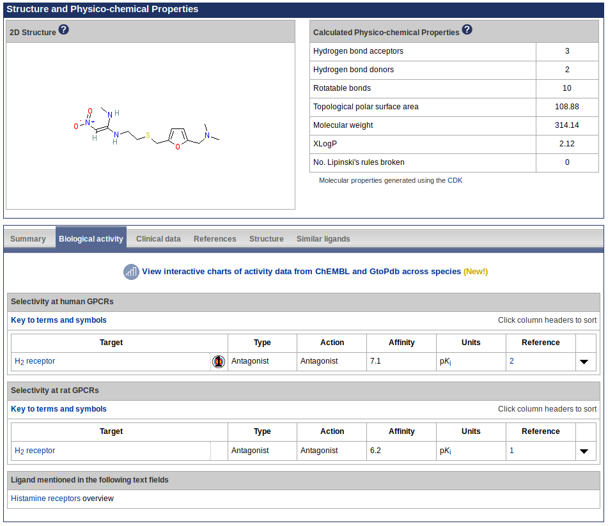
Biological activity data for ranitidine at targets in the database

Slide 34
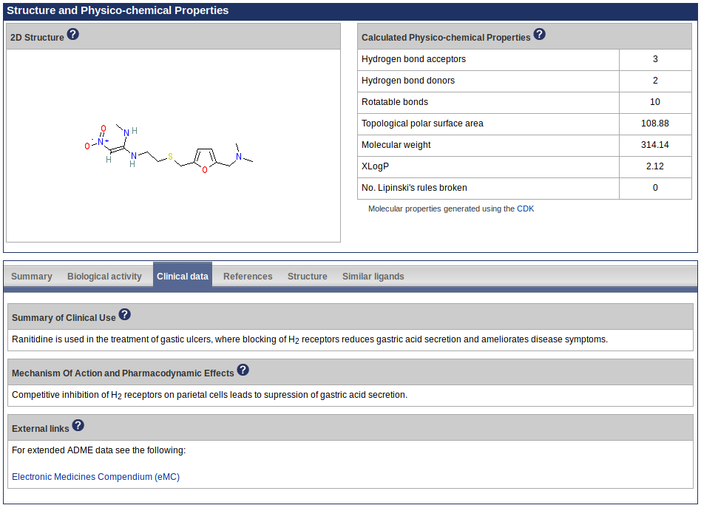
Clinical use and mechanism of action for ranitidine

Slide 35
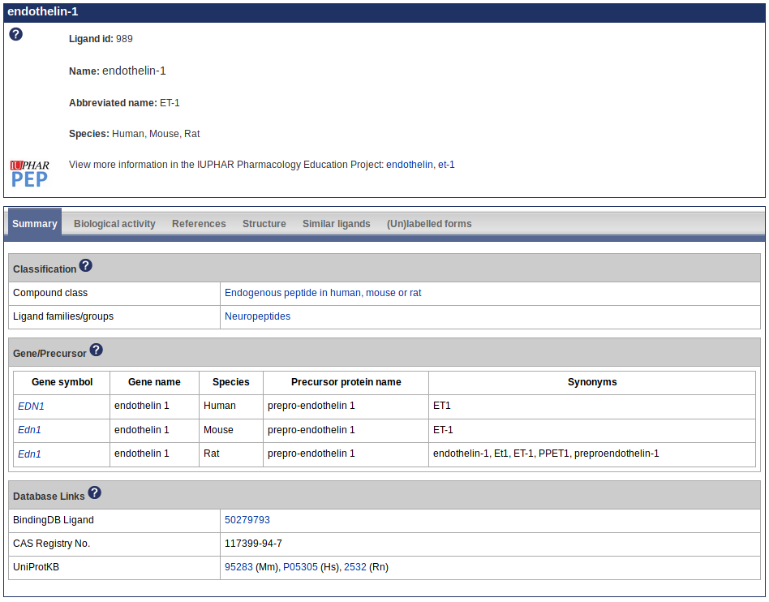
Peptide ligand information
Curated sequence information
Post-translational and chemical group modifications
Precursor proteins and encoding genes
Similar sequences
Gene families
Ligand page for the endogenous peptide endothelin-1

Slide 36
Bespoke tables for different targets
Heteromeric complexes: subunit composition
GPCRs: signal transduction mechanism
Ion channels: ion conductance and voltage-dependence
Nuclear receptors: DNA co-binding partners, target genes
Enzymes: substrates, cofactors, reaction mechanisms
Transporters: substrates
Antimalarial targets: whole organism assays
GABA_{B} receptor
isopentenyl-diphosphate Δ-isomerase 1

Slide 37
Database search functionality
Quick search box at the top of every page with autocomplete for target, family and ligand names
Advanced searches are available on the Target Search and Ligand Search pages

Slide 38
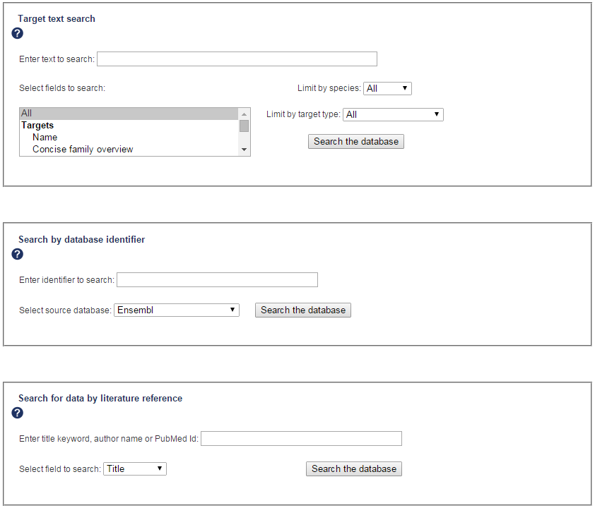
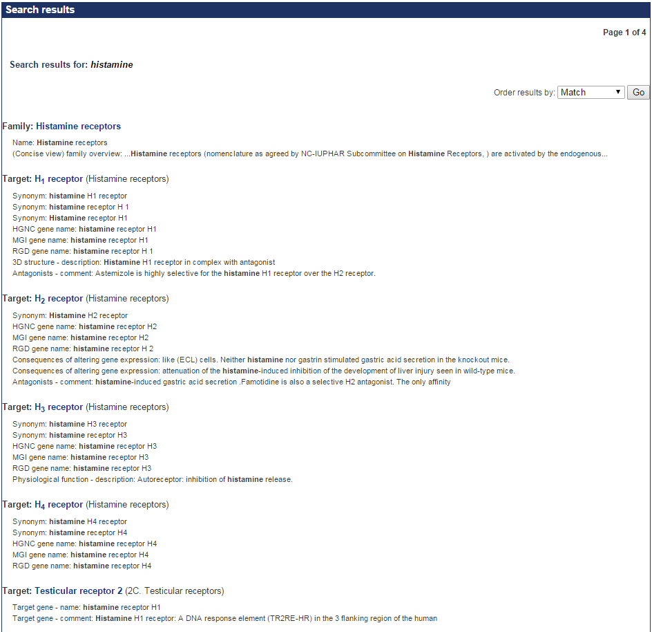
Target search tools
Search by name or keyword, identifier (e.g. UniProtKB accession) or reference (e.g. PubMed id)

Slide 39
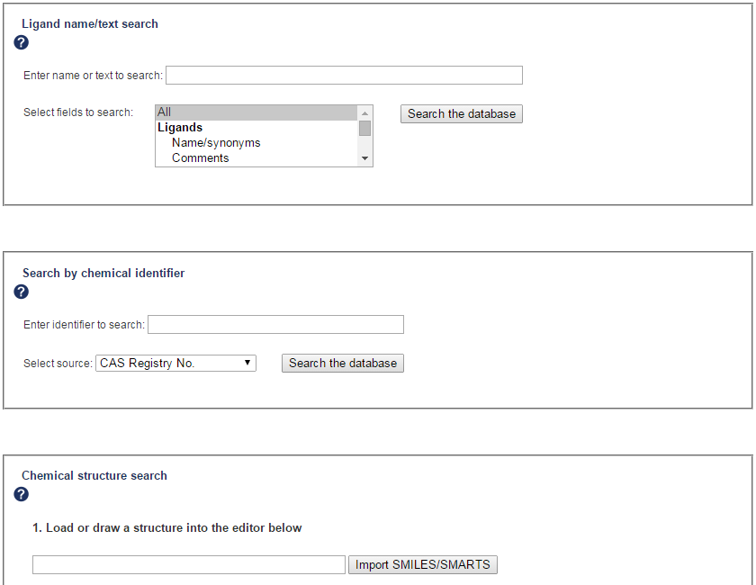
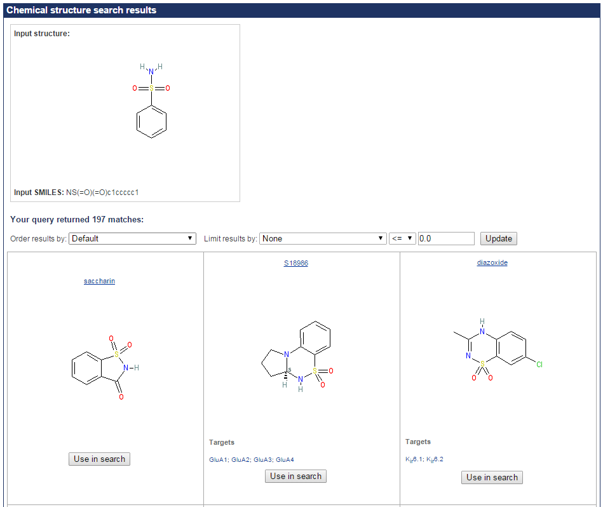
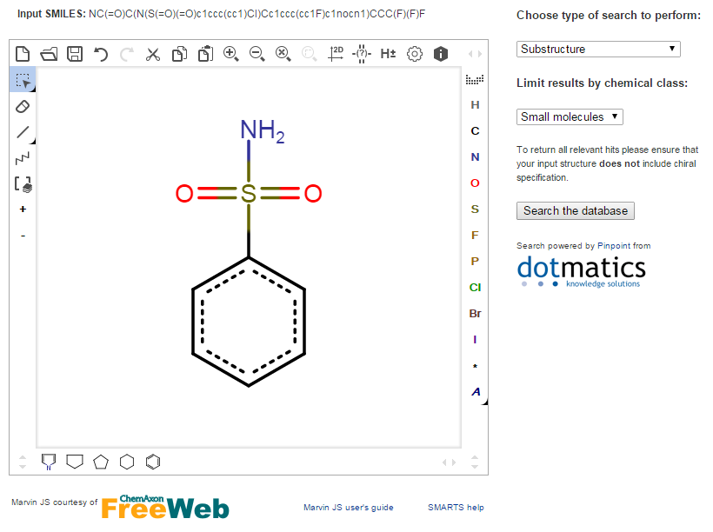
Ligand search tools
Search by name, identifier (e.g. PubChem CID, InChI) or structure (exact match, similarity, substructure, SMARTS)

Slide 40
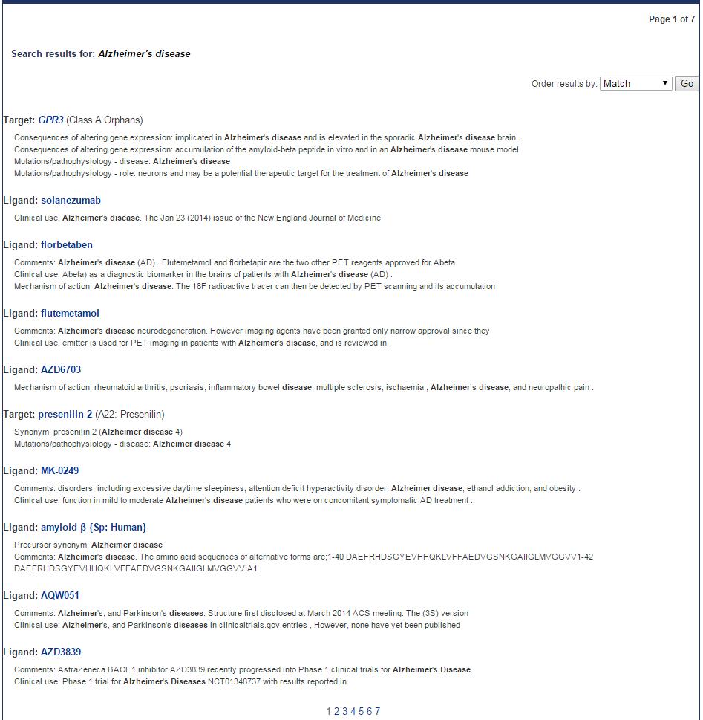
Advanced search by keyword
Keyword searches, for example by disease name, can facilitate retrieval of associated ligands and targets
A search for “Alzheimer’s disease” returns implicated targets and ligands tested in clinical trials

Slide 41
Recent additions and expansions

Slide 42
Recent additions and expansions
Antibodies
Kinases
Proteases and hydrolases
Epigenetic targets
Regulators of G protein Signaling (RGS) proteins
Targets relevant to immunopharmacology, including:
Transcription factors
Immune checkpoint proteins
Fc epsilon receptors
Absent in melanoma (AIM)-like receptors (ALRs) and C-type lectin-like receptors (CLRs) within Pattern Recognition Receptors
Antimalarial ligands and targets
Ligand families

Slide 43
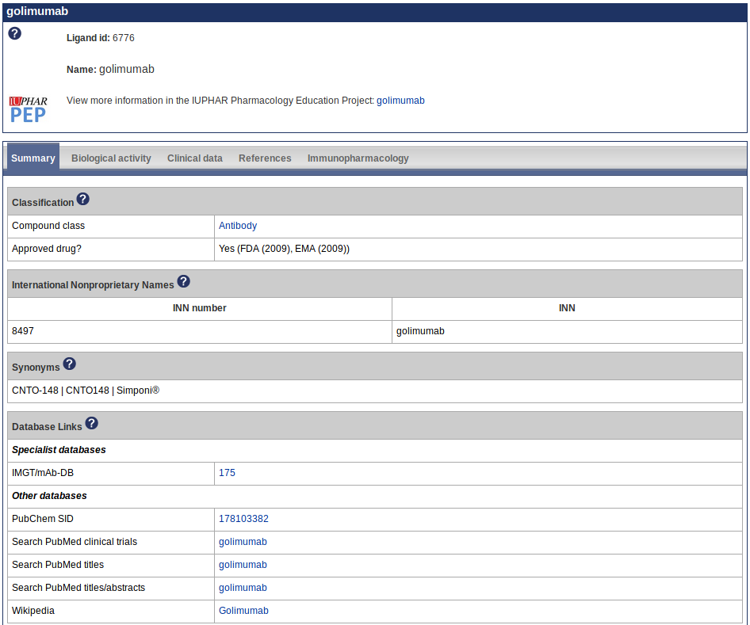
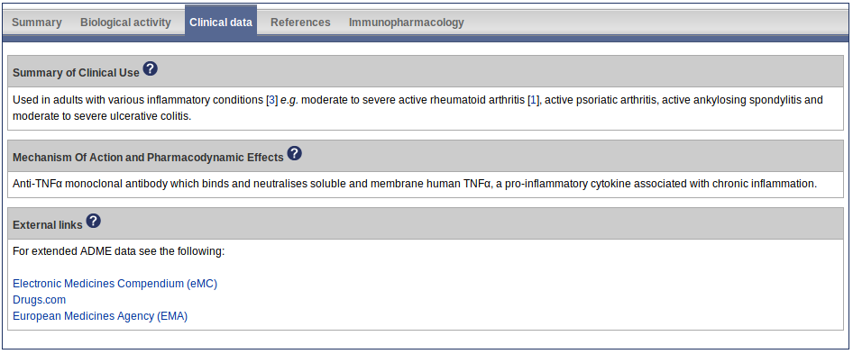
Information on antibodies
Collaboration with IMGT®, the international ImMunoGeneTics information system®
Pharmacological data on 224 approved and experimental therapeutic monoclonal antibodies
Database page for the antibody golimumab

Slide 44
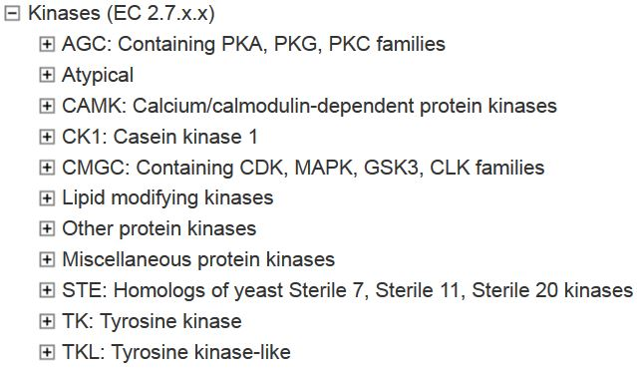
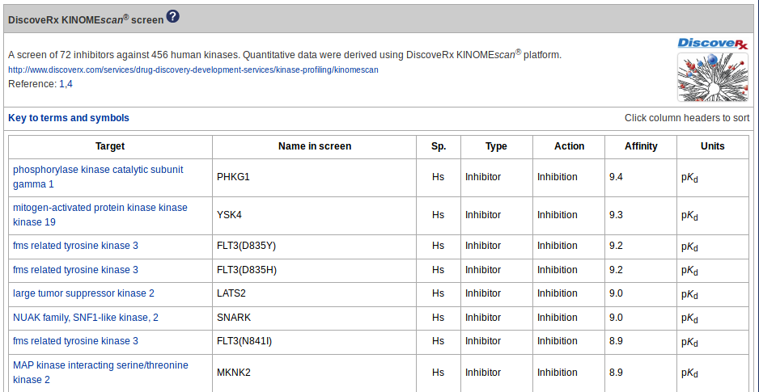
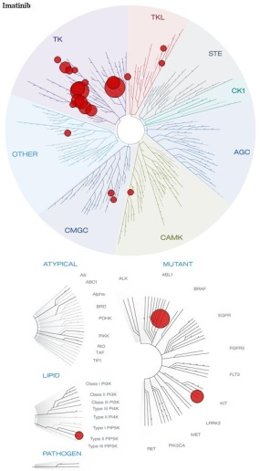
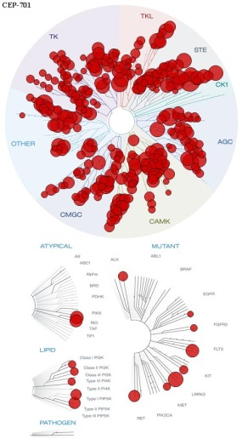
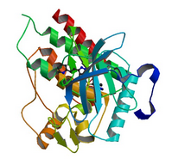
Information on kinases
Database pages created for all the human protein kinases and selected lipid kinases
Detailed annotation for the ~30 clinically-used kinase inhibitors, including target affinities, clinical use, and ADME (absorption, distribution, metabolism and excretion) data
Panel data from published screening assays by DiscoveRx, EMD Millipore and Reaction Biology
Links to the DiscoveRx TREEspot™ compound profile visualisation tool
imatinib
lestaurtinib

Slide 45
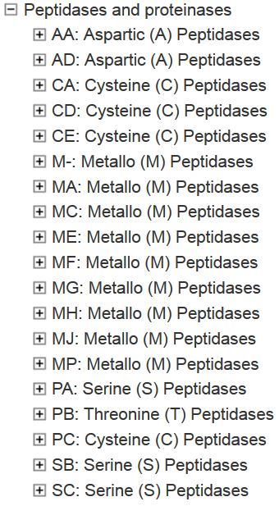
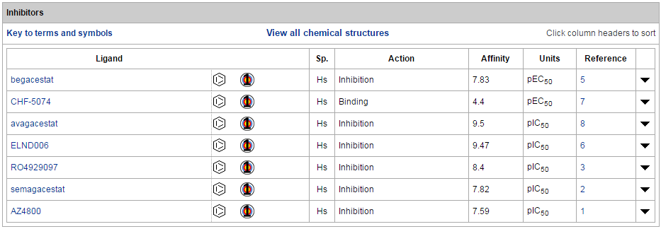
Information on proteases and hydrolases
MEROPS classification system adopted
Database pages for 175 proteases and 14 hydrolases/lipases with activity records in ChEMBL
Ligand activity (K_{i} or IC₅₀) data curated for approved drugs, prodrugs, clinical candidates (e.g. BACE1 for Alzheimer’s), and selected research compounds
presenilin 1

Slide 46
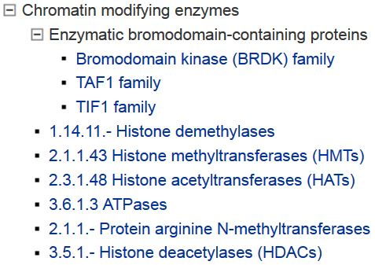
Information on epigenetic targets
GtoPdb includes ~130 epigenetic targets (chromatin modifying enzymes and bromodomain-containing proteins), along with activity data for published inhibitors
Tough DF et al. (2014) Epigenetic pathway targets for the treatment of disease: accelerating progress in the development of pharmacological tools: IUPHAR Review 11. Br J Pharmacol., 171: 4981–5010.

Slide 47
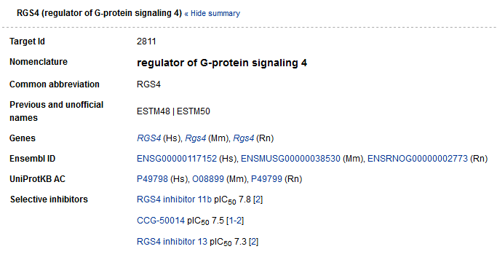
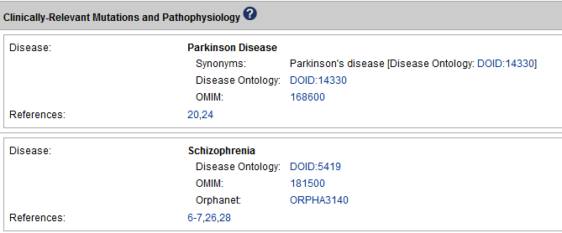
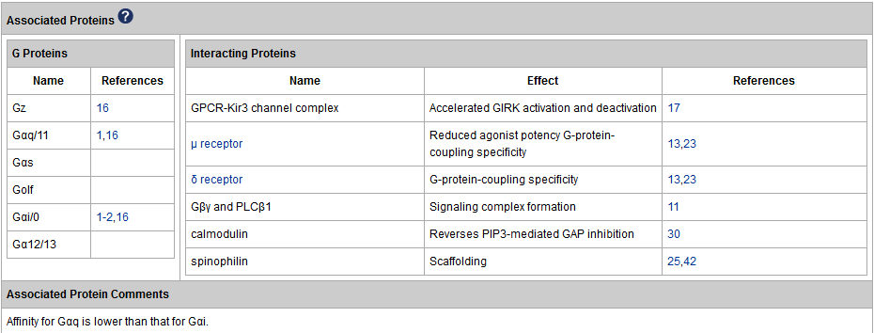
Information on RGS proteins
Includes all members of the four RGS protein subfamilies, along with information about interacting proteins, activity data for published pharmacological tools, tissue distribution, physiological functions, and disease relevance for the more extensively studied RGS proteins
Sjögren B. (2017) The evolution of regulators of G protein signalling proteins as drug targets - 20 years in the making: IUPHAR Review 21. Br J Pharmacol. 174(6):427-437.

Slide 48
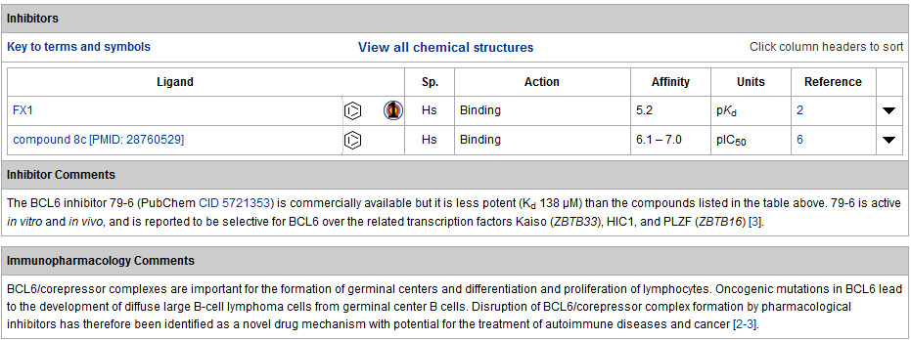
Information on transcription factors (relevant to immunopharmacology)
This is a small but dynamic family with new members and pharmacological data being added when reported in the literature

Slide 49
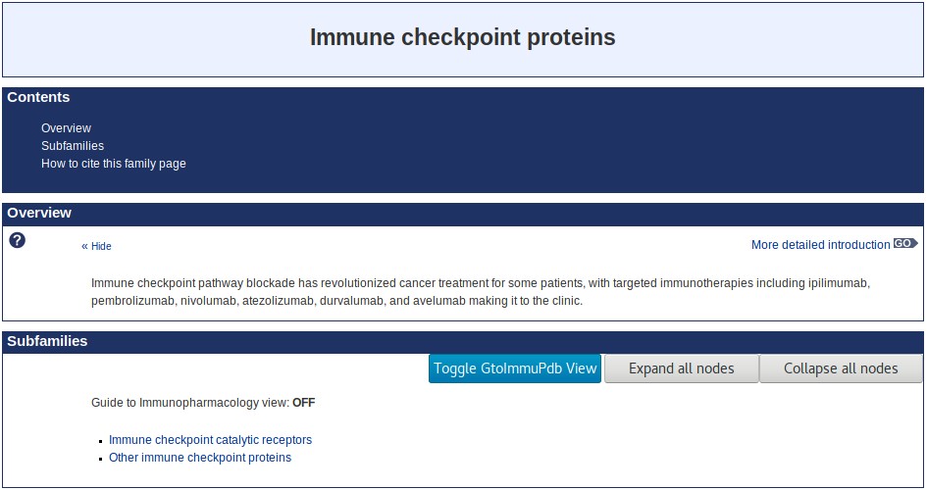
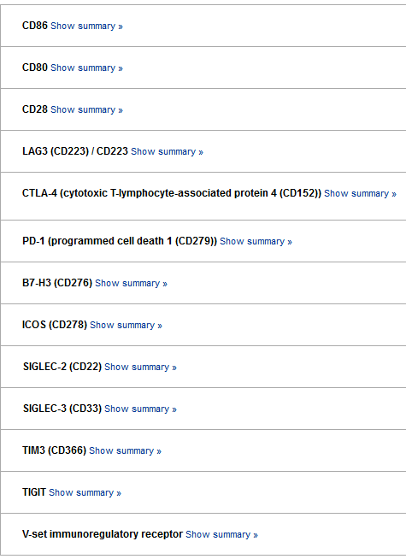
Information on immune checkpoint proteins
This family consolidates existing GtoPdb targets with new family members in a single place for easy user access

Slide 50
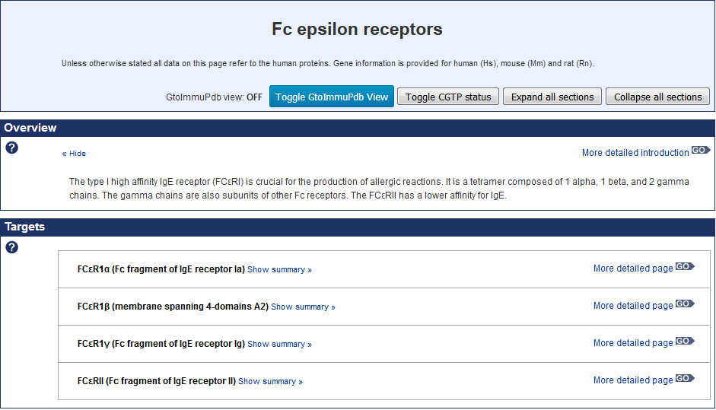
Information on Fc epsilon receptors
This family is included because these receptors are crucial in the development of allergic reactions, although specific pharmacology is sparse

Slide 51
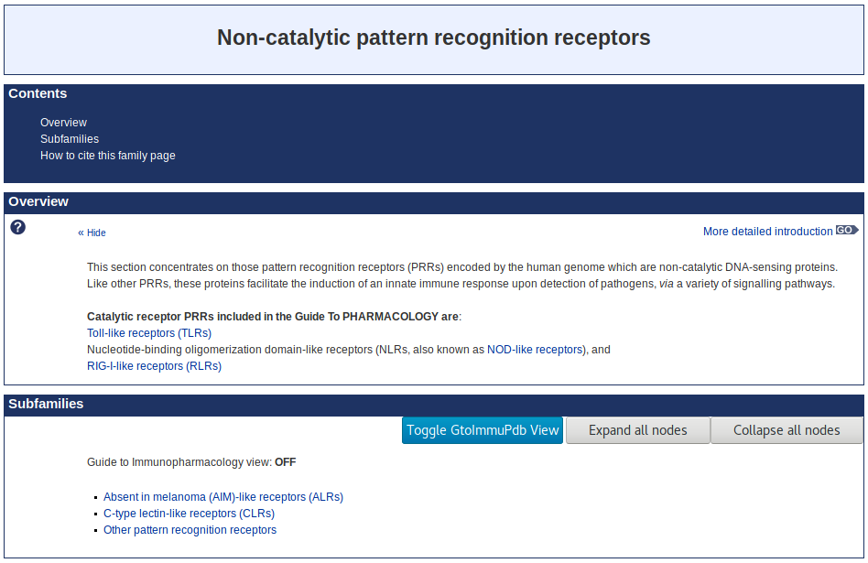
Information on pattern recognition receptors
This family consolidates existing GtoPdb targets across different target classes, with new family members, in a single place for easy user access
Bryant et al. (2015) International Union of Basic and Clinical Pharmacology. XCVI. Pattern recognition receptors in health and disease. Pharmacol Rev. 67(2):462-504.

Slide 52
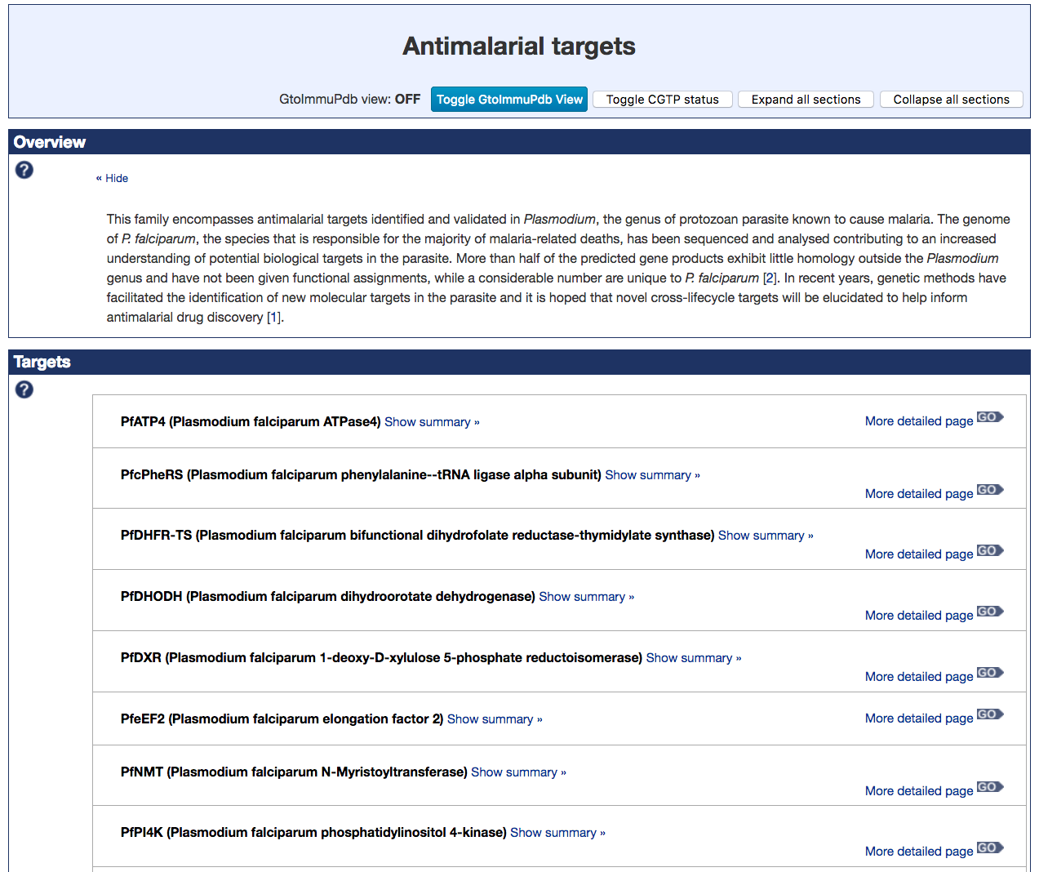
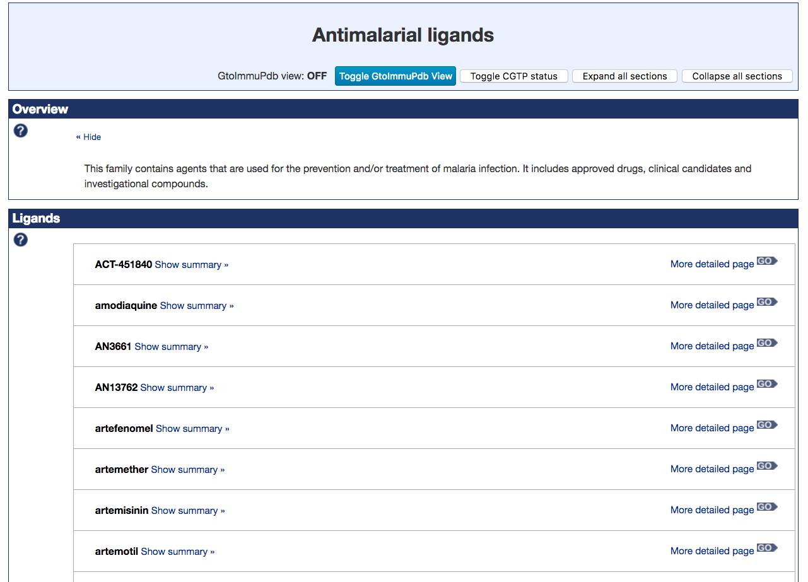
Information on antimalarial ligands and targets
New families introduced as part of the IUPHAR/MMV Guide to Malaria Pharmacology project (GtoMPdb)

Slide 53
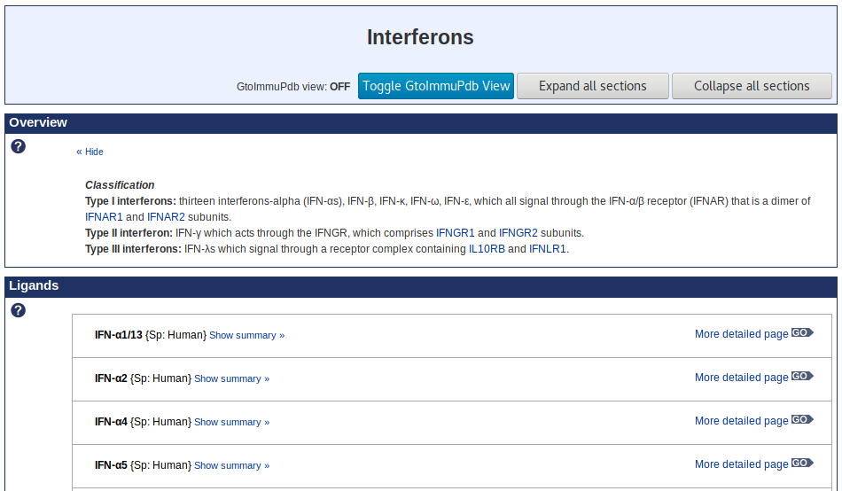
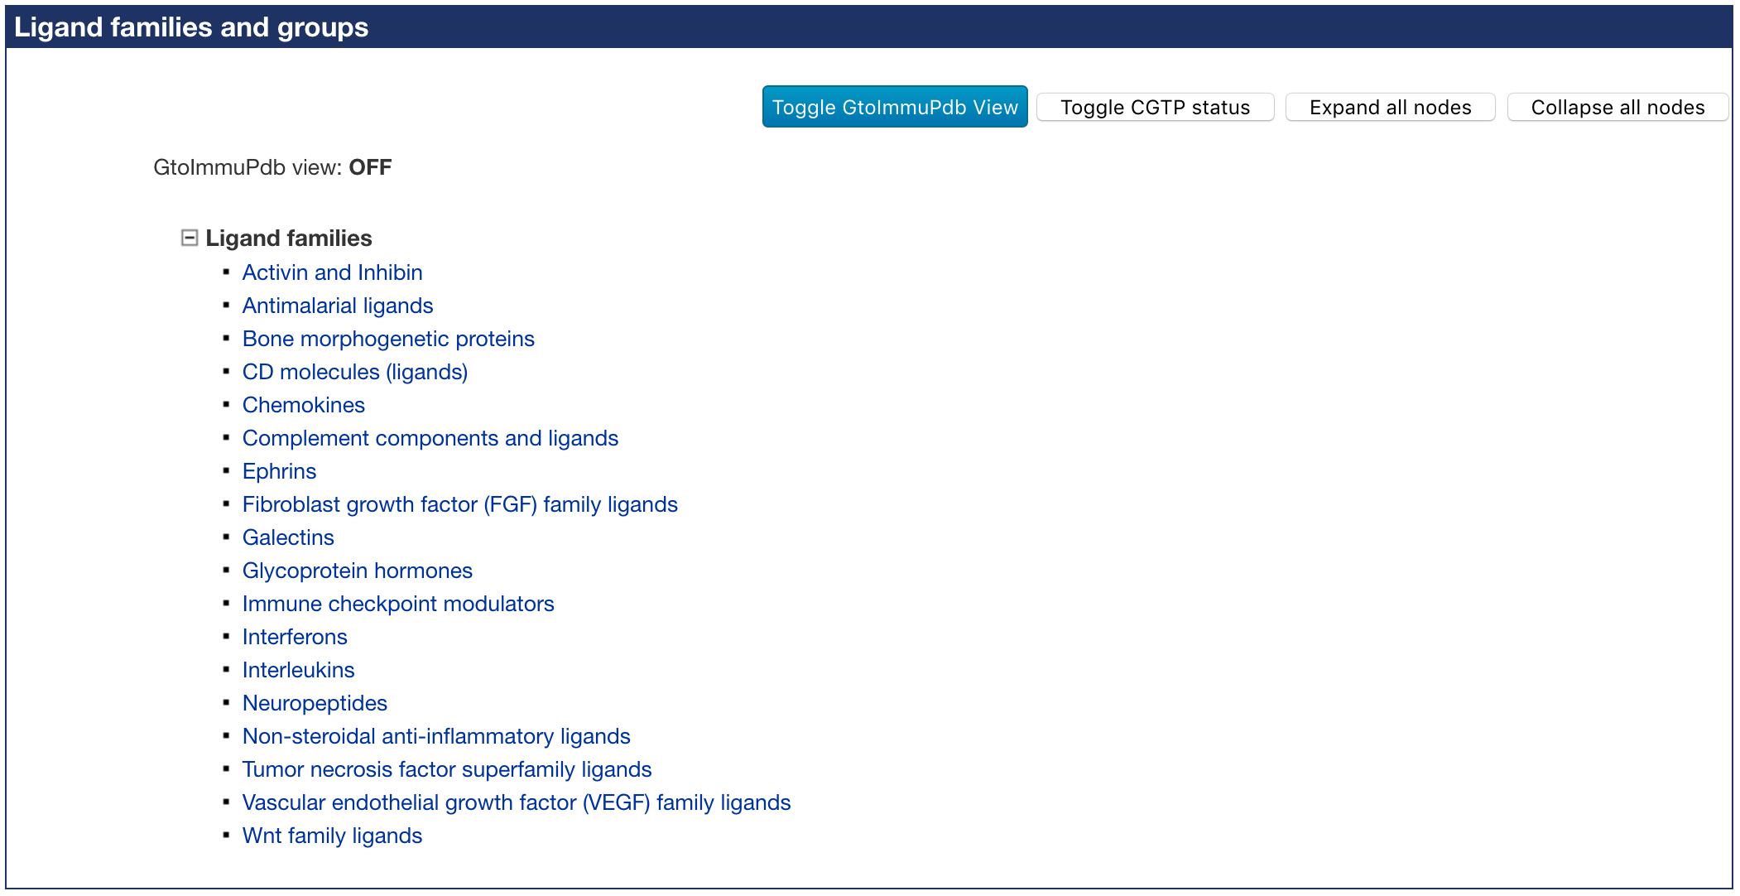
Information on ligand families
New ligand family and group listing gives easy access to groups of ligands with shared homology, functions or mechanism of action

Slide 54
The Concise Guide to PHARMACOLOGY

Slide 55
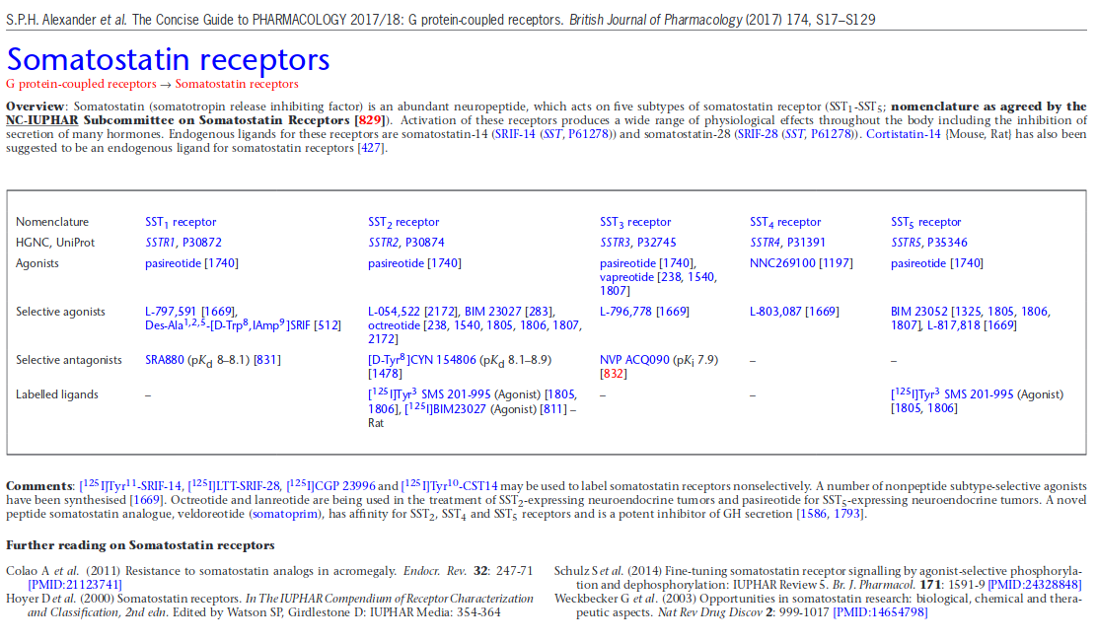
The Concise Guide to PHARMACOLOGY
A publication snapshot created from the target family summaries in GtoPdb
At-a-glance view of target properties - a quick desktop reference guide
Published biennially in the British Journal of Pharmacology (the basic pharmacology journal of the BPS)
PDFs include embedded hyperlinks to target and ligand entries in GtoPdb, PubMed, HGNC and UniProt
Alexander SPH et al. (2017) The Concise Guide to PHARMACOLOGY 2017/18. Br J Pharmacol. 174 (Suppl 1): S1-S446.

Slide 56
The iuphar guide to immunoPHARMACOLOGY

Slide 57
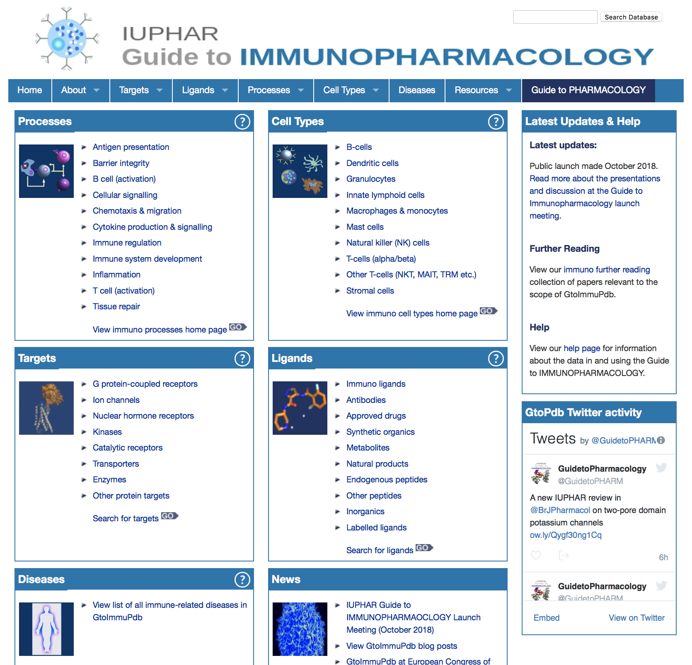
A new portal linking GtoPdb targets and ligands to immunological cell types, processes and diseases
Developed in conjunction with immunologists to include the data types and navigation routes most relevant to immunology
Immuno-relevant targets and ligands in GtoPdb have been flagged and annotated with supporting data
Officially launched in October 2018
www.guidetoimmunopharmacology.org

Slide 58
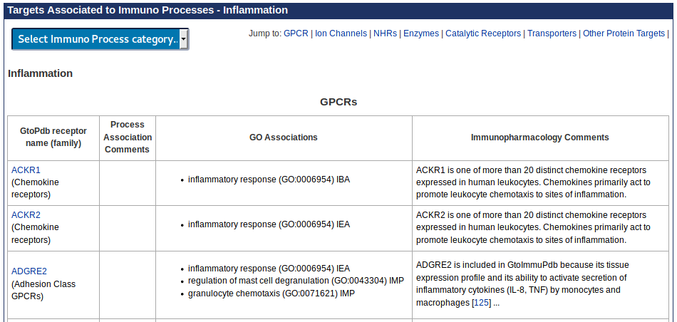
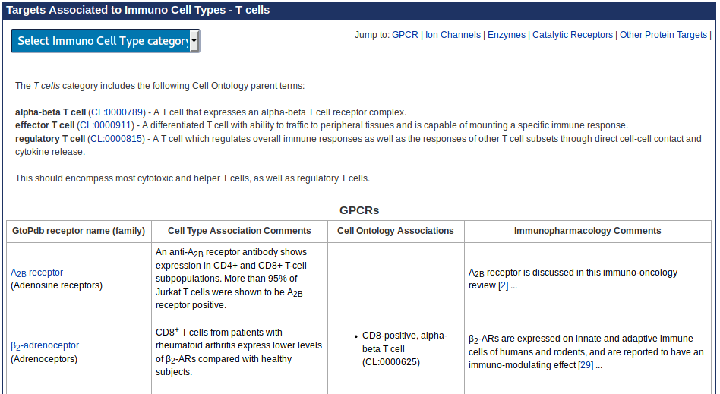
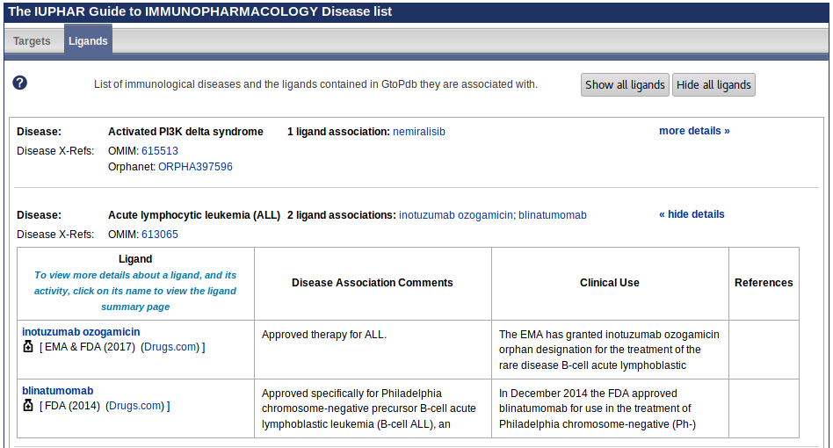
Browsing new GtoImmuPdb data types
Browse by cell type or immunological process to find targets
Browse by disease to find targets and drugs

Slide 59
Browsing immunological targets
GtoPdb families with immuno-relevant targets are highlighted
Detailed target page with immunopharmacology data
Immuno-ligand icon

Slide 60
Browsing immunological ligands
Immuno-relevant ligands are highlighted
Portal includes a list of all immuno-ligands

Slide 61
The iuphar/MMV guide to MALARIA PHARMACOLOGY

Slide 62
Funded by Medicines for Malaria Venture (MMV) to curate antimalarial compounds and their Plasmodium molecular targets
Provide a new portal to the existing GtoPdb that is optimized for the malaria research community
Includes lead structures, target sequences and efficacy data integrated across global efforts
The new resource, the IUPHAR/MMV Guide to Malaria Pharmacology (GtoMPdb), will be freely available, richly annotated and regularly updated
www.guidetomalariapharmacology.org

Slide 63
GtoMPdb Data
New target classification – Antimalarial Targets
Initial set included 9 Plasmodium falciparum targets
New ligand classification – Antimalarial Ligands
An initial set of ~40 were available in the 2018.4 release
Categories are likely to be further sub-divided
Includes a tag for submitted structures to PubChem

Slide 64
GtoMPdb Portal
Customised views of the data have been developed
Ability to browse not only by target and ligand, but by target species and parasite lifecycle stage (shown here)

Slide 65
Additional features and resources

Slide 66
Additional features and resources
FAQ, Tutorial and Help pages (http://www.guidetopharmacology.org/helpPage.jsp)
NC-IUPHAR nomenclature guidelines (http://www.guidetopharmacology.org/nomenclature.jsp)
NC-IUPHAR and GtoPdb publication list (http://www.guidetopharmacology.org/nciupharPublications.jsp)
Hot topics in pharmacology and latest receptor-ligand pairings (http://www.guidetopharmacology.org/news.jsp)
GtoPdb data downloads (http://www.guidetopharmacology.org/download.jsp)
RDF flat files of target-ligand interaction data (http://www.guidetopharmacology.org/download.jsp#rdf)
REST web services for computational access to data in JSON form (http://www.guidetopharmacology.org/webServices.jsp)
Blog posts about database updates, curatorial and technical aspects, and hot topic commentaries (http://blog.guidetopharmacology.org/)

Slide 67
The pharmacology education project
An IUPHAR learning resource

Slide 68
A free learning resource to support education and training in the pharmacological sciences
www.pharmacologyeducation.org
@PharmacologyEd
Pharmacology
Clinical pharmacology
Drugs
Therapeutics
Please contribute content to this growing resource by visiting the website or email admin@pharmacologyeducation.org

Slide 69
Stay in touch
Receive email alerts for new content and news items
Follow us on
Download slides and posters
Email us with any questions, comments, suggestions enquiries@guidetopharmacology.org
@GuidetoPHARM

Slide 70
Acknowledgements
The late Prof Tony Harmar, founder and original PI
Michael Spedding, Steve Alexander, Anthony Davenport, John Peters and all past and present members of NC-IUPHAR
NC-IUPHAR subcommittees and Concise Guide to PHARMACOLOGY editors and contributors
Database team:
Jamie Davies (Principal Investigator)
Simon Harding, Joanna Sharman (Developers)
Adam Pawson, Elena Faccenda, Christopher Southan, Jane Armstrong (Curators)
Toni Wigglesworth (Project Administrator)
All database team alumni
All current and past NC-IUPHAR and website sponsors
IUPHAR/BPS Guide to PHARMACOLOGY funders:

Slide 72
APPENDIX
TEMPLATE SLIDES

Slide 73
Live demos at this meeting
Booth # X
Booth # X

